Slide 1
Personal Safety in the Hospital Setting
0.5 CE
Directions for Completion
Before proceeding to the posttest, be sure you have completed the review of the PowerPoint®
Exit and complete the posttest which is final step of this education.
“Take Test”.
Remember, no attendance record is needed.
Completion of the posttest will be sent electronically to your EduTracker record once a 100% is achieved.
Print the Certificate of Completion for your records if desired.
Comments, question, or suggestions can be directed to your manager, a supervisor, or your Security Department.
St. Luke’s University Health Network
Fall 2014

Slide 2
Purpose
This program has been developed to assist SLUHN staff prepare for and respond to violent/potentially violent or aggressive situations in the workplace.
After completing the program, the learner will be able to:
Identify high risk patient situations where there is potential/ actual violence or aggression
Assess the environment
Take appropriate measures to enhance personal safety
Respond safely to a potentially violent situation or an elopement
Employ de-escalation techniques

Slide 3
The intention of this program is not to frighten you, but to better equip you with information & tools to enhance your personal safety while caring for patients (or visitors) with known violent tendencies, potential for violence, unpredictable behavior, and/or those who are or may be suicidal.

Slide 4
Introduction
Workplace violence affects health care & social service workers.
The National Institute for Occupational Safety & Health (NIOSH) defines workplace violence as "violent acts (including physical assaults and threats of assaults) directed toward persons at work or on duty."
For many years, health care & social service workers have faced a significant risk of job-related violence. Assaults represent a serious safety and health hazard within these industries.
Extent of the problem
The Bureau of Labor Statistics data shows that in 2000, 48 percent of all non-fatal injuries from occupational assaults & violent acts occurred in health care & social services. Most of these occurred in hospitals, nursing and personal care facilities, & residential care services. Nurses, aides, orderlies & attendants suffered the most non-fatal assaults resulting in injury.
Retrieved on September 25, 2014 from https://www.osha.gov/Publications/OSHA3148/osha3148.html

Slide 5
Risk Factors for Violence
According to OSHA, health care & social service workers face an increased risk of work-related assaults stemming from several factors.
These include:
The prevalence of handguns & other weapons among patients, their families or friends;
The increasing use of hospitals by police & the criminal justice system for criminal holds & the care of acutely disturbed, violent individuals;
The increasing number of acute & chronic mentally ill patients being released from hospitals without follow-up care (these patients have the right to refuse medicine & can no longer be hospitalized involuntarily unless they pose an immediate threat to themselves or others);
Factors such as the unrestricted movement of the public in clinics & hospitals and long waits in emergency or clinic areas that lead to client frustration over an inability to obtain needed services promptly;
The increasing presence of gang members, drug or alcohol abusers, trauma patients or distraught family members;
Lack of staff training in recognizing and managing escalating hostile & assaultive behavior.
Retrieved on September 25, 2014 from https://www.osha.gov/Publications/OSHA3148/osha3148.html

Slide 6

Being Prepared for a Potentially Violent/Aggressive Situation

Slide 7


Aggressive people can be patients or visitors !
Trust Him?
Trust Her?

Slide 8
The reality is, either of the people in the preceding slide could be/become aggressive or violent or escalate.
What does escalating behavior look like?
Signs to look for that may indicate a change in the person. He or she:
exhibits visibly aggressive behavior
had been talkative, is now eerily quiet
begins pacing back & forth
verbalizes dissatisfaction in an angry tone
begins making threats toward staff or hospital
begins acting out physically

Slide 9
What to do if someone is “escalating”…
De-escalation techniques
Always speak in a calm, confident, & firm manner
Never say “calm down” to an escalating patient
Answer information-seeking questions briefly
Acknowledge the behavior, offer assistance and take the HEAT
  H - Hear without interrupting
  E – Empathize (ex. “___ must be upsetting for you.”)
  A – Apologize for their perceived issue (ex. “I’m sorry that you have to be in the
  hospital so long.”)
  T – Take action (ex. “I’ll let your nurse know.”)
Take all threats seriously; immediately notify the patient’s RN or the charge nurse, and/or seek help from Security.

Slide 10

The point of using de-escalation techniques is to help calm the person before the situation gets worse…
Try to remain calm yourself!

Slide 11
Sometimes, more help is needed to control the situation…
How to get immediate help:
Dial 5555 – to notify Security personnel & other responders that a situation is escalating or has escalated (gotten worse or unmanageable)
Control Team: say “Control Team”, provide location
  this will be an overhead announcement
  all available personnel will come to assist with the situation (anticipate 5 or more responders)
Security Assistance: say “Security STAT”, provide location
  this will alert Security to come stat to the situation to assist
  anticipate 1 up to 2 Security personnel responders
Elopement: say “ Patient Elopement”, provide location
  provide Operator with the patient name, age, gender, physical description, description of clothing worn, last known location

Slide 12

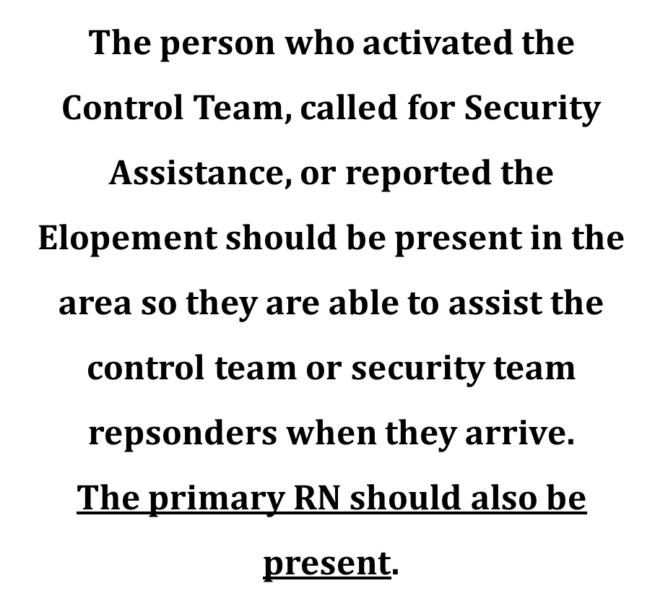


Slide 13
If your role requires you to respond to a Security Alert or to assist with a violent/aggressive situation…
Personal safety first…
All personnel entering the area/room should:
Remove name tag/holders, pins, stethoscope, pens or pencils, pen lights, scissors, other sharps, etc. from uniform/clothing.
You want to ensure that you do not have anything on you or in pockets that could be used as a weapon or to cause injury to you, other staff, or the aggressive person.

Slide 14
Personal Safety Considerations when providing care for patients ordered for Continual Observation
How to Prepare For & Respond to
Violent/Potentially Violent Patient Situations & Elopements

Slide 15
Your unit is getting a continual observation patient or is initiating a continual observation on a patient…
NOW WHAT?
Is the patient violent? Has a Control team called? Is the patient an elopement risk?
  All patients on continual observation should be considered potentially violent.
  All patients on continual observation should be considered potential elopement risks.
  All patients admitted for attempted suicide should be considered “suicidal”.
If a violent/potentially violent patient or one at risk for elopement is in a continual observation, the first step is for the charge RN to contact the hospital supervisor.
The hospital supervisor will then contact Security.
Security will assess the risks & collaborate with the PCM/Supervisor/ Charge Nurse to determine who will perform the continual observation.

Slide 16
Environmental & Self Awareness
Room readiness prior to patient’s arrival or upon initiation of the continual observation:
  Remove items that can be considered dangerous
    IVs, poles, call bells, oxygen flow meter, suction meter, O2 and suctions canisters/tubing, bag mask device, manual blood pressure cuffs, telephone, plastic bags, wire/plastic hangers, rope, string or cords or any kind
    Other items: shoelaces, tape, alcohol swabs
Personal safety – all personnel entering the room!
  Remove name tag/holders, pins, stethoscope, pens or pencils, pen light, scissors (anything sharp)
  Do not take items that will distract you from your purpose:
    Examples: personal cell phones, books, homework, etc.
Be alert & aware of the environment as well as the patient’s actions
Always introduce yourself to the patient when entering the continual observation room & explain you will staying in their room as a safety measure.

Slide 17
Reminders when performing a Continual Observation…
Obtain full SBAR report from previous staff in continual observation room & from RN taking care of the patient so you know what to expect & what the patient’s normal baseline behavior has been for the previous shift.
Ask questions regarding the expected patient care & whether the patient has had any violent, aggressive, or suicidal episodes.
Review patient’s SBAR & Continual Observation SBAR (NEW).
Call out for help if you need it.

Slide 18
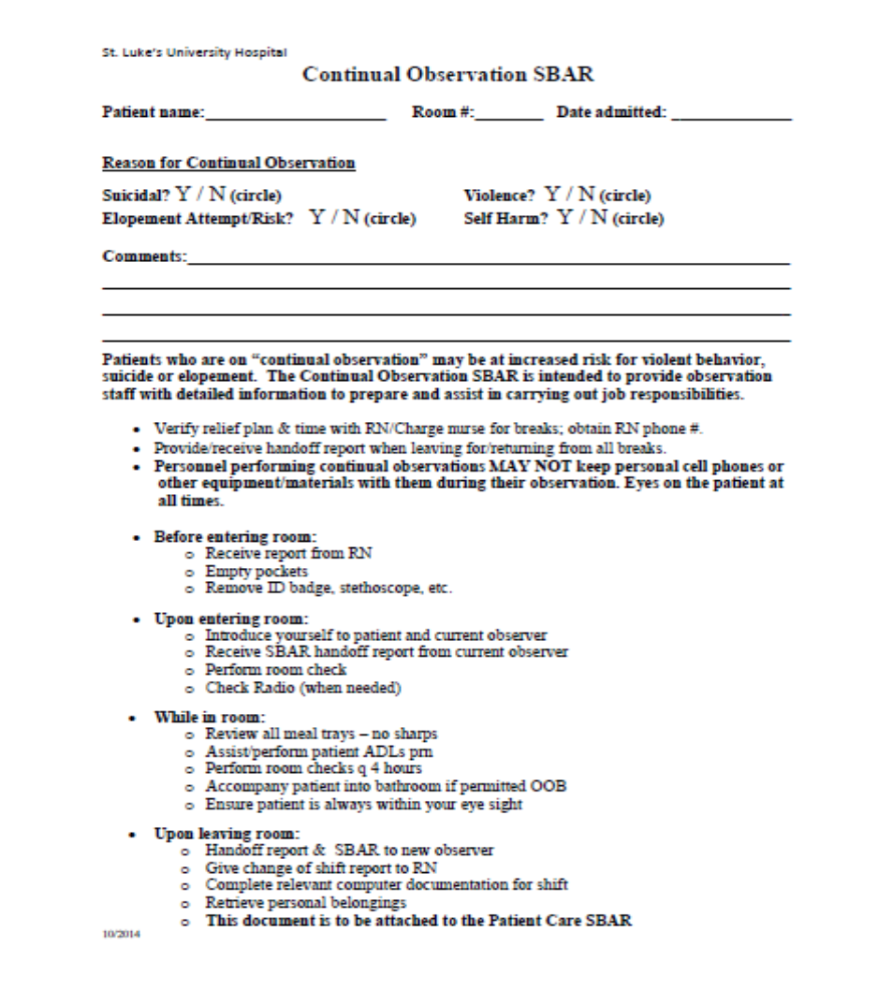
Continual Observation SBAR
Continual Observation SBAR has been developed to assist with shift-to-shift & observer-to-observer communication.
It attaches to the patient’s clinical SBARs (RN & PCA) and is updated as needed.
This tool is intended to provide reminders to the involved direct care givers.

Slide 19
Other Tools
  Security Radio
In some cases for violent patients or ones at risk for elopement, it may be necessary for a security officer to provide a hand held radio to the floor to keep in the continual observation room.
  Security will train staff on how to use the radio.
  In the event of a violent situation or elopement, the observer will have direct communication with the security team.
  Panic Button
  Panic buttons are installed on units/departments where there are higher volumes of patients who may be at risk for aggression/violence (ex: some EDs & ICUs).
  All staff members in these areas are trained by Security on how to use the panic button.
  Use of the panic button is for an emergent situation when Security is needed to respond STAT.

Slide 20

Violent Patient / Elopement Debriefing Huddle
Culture of Safety
New debriefing process takes place after a violent patient situation or elopement
Discuss & review situation to help prevent future events
Participation of all team members involved is strongly encouraged
Use as a basis to revise the patient’s treatment plan

Slide 23


Slide 24
Summary of Key Points
Violence & aggressive behavior has become more frequent in healthcare settings.
Be prepared for potential situations:
  Maintain a safe distance between yourself & aggressive or potentially aggressive patients/others.
  Do not turn your back on people who are escalating; position yourself so you are not boxed into a corner or a room or hallway in the event the person becomes physically violent.
  Report any changes noticed in patients’ behaviors to the primary RN or charge nurse ASAP.
  If a patient with violent or aggressive behavior tries to leave the hospital (patient elopement), move aside & let them go; be sure to notify security ASAP.
    DO NOT chase after the patient; you may follow at a safe distance with a coworker to keep the patient in your sight until Security arrives (or to update Security with the patient’s last known location or direction of travel).
    DO NOT follow onto elevators, down stairwells, through abandoned corridors/departments, or outside the hospital.
  Know how to respond if a patient or visitor begins to speak, act, or threaten in a violent or aggressive manner.

Slide 25
Resources
Some of our patients who are suicidal, aggressive, and/or potentially violent, may have an order for Continual Observation for their safety.
If you are in a position that may require you to perform a continual observation for a patient, make sure you’ve reviewed the appropriate education program within the calendar year:
MyNET > Learning tab > Staff Ed tab > Continual Observation
Contact your manager or supervisor with any questions you have about personal safety while at work
Contact Security (x5555) for assistance with aggressive, violent, or potentially violent situations

Slide 26

St. Luke’s University Hospital Presentation Development Team
Peter Deringer, Nursing Professional Practice Coordinator
Alan Lynch, Network Director – Safety & Security
Jill Shultz, ICU Patient Care Manager
Laurie Smickle, PPHP5 Clinical Coordinator
Kathleen Willner, Director of Educational Services
Christina Zelko Bennick, Director of Patient Care Services

