Slide 1
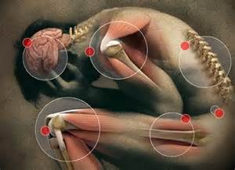
Pain
Management
for
Nurses
Completion of this program and posttest will provide 0.5 CE for nurses.
Annual Pain Management Education
SLUHN - 2015
Notes:
Picture tinted in four colors
(Basic)
To reproduce the background on this slide, do the following:
On the Home tab, in the Slides group, click Layout, and then click Blank.
On the Insert tab, in the Images group, click Picture.
In the Insert Picture dialog box, select a picture, and then click Insert.
Under Picture Tools, on the Format tab, in the Size group, in the Shape Width box, enter 5”.
On the Home tab, in the Drawing group, click Arrange, point to Align, and then do the following:
Click Align to Slide.
Click Align Left.
Click Align Top.
On the Home tab, in the Clipboard group, click the arrow to the right of Copy, and then click Duplicate. Repeat this process to create a total of four pictures.
Select one of the duplicate pictures. On the Home tab, in the Drawing group, click Arrange, point to Align, and then do the following:
Click Align Right.
Click Align Top.
Select another one of the duplicate pictures. On the Home tab, in the Drawing group, click Arrange, point to Align, and then do the following:
Click Align Left.
Click Align Bottom.
Select the final duplicate picture. On the Home tab, in the Drawing group, click Arrange, point to Align, and then do the following:
Click Align Right.
Click Align Bottom.
Select the top left picture. Under Picture Tools, on the Format tab, in the Adjust group, click Recolor, and then under Color Modes click Sepia (second option from the left).
Select the top right picture. Under Picture Tools, on the Format tab, in the Adjust group, click Recolor, and then under Dark Variations click Accent color 3 Dark (fourth option from the left).
Select the bottom left picture. Under Picture Tools, on the Format tab, in the Adjust group, click Recolor, and then under Dark Variations click Accent color 5 Dark (sixth option from the left).
Select the bottom right picture. Under Picture Tools, on the Format tab, in the Adjust group, click Recolor, and then under Dark Variations click Accent color 6 Dark (seventh option from the left).

Slide 2
Pain Management for Nurses
Be sure to set and view this program in Slide Show format.
Annual Pain Management Education
SLUHN - 2015

Slide 3
Pain Management for Nurses
It is imperative that you proceed through this program using mouse clicks.
CLICK
CLICK
CLICK
CLICK
CLICK
CLICK
CLICK
CLICK
CLICK
CLICK
Annual Pain Management Education
SLUHN - 2015

Slide 4
Pain Management for Nurses
Program Objectives
Review The Joint Commission pain management guidelines.
Highlight key role-specific practice expectations regarding pain management.
Review various interventions for managing pain.
Understand how to integrate multimodal analgesia into the pain management treatment plan.
Review appropriate analgesic dosing.
Annual Pain Management Education
SLUHN - 2015

Slide 5
Pain Management The Joint Commission: Safe Use of Opioids in Hospital
To optimize patient safety and prevent opioid related adverse events, The Joint Commission recommends that hospitals take the follow evidence-based actions…
Create and implement policies/procedures to:
Continuously monitor patients receiving opioid therapy
Track opioid related incidents
Allow for a second level review by a pain management specialist or pharmacist
Use information technology to monitor the prescribing of opioids
Use both non-pharmacological and pharmacological alternatives, including multi-modal adjuvant therapies
Provide pain management education and training for all staff
Educate and provide written instructions to patients and families
Provide standardized tools to screen patients for risk factors associated with over-sedation and respiratory depression
The Joint Commission (2012)

Slide 6
Pain Management The Joint Commission Practice Highlights
For safe and effective pain management…
Conduct a thorough history and full body assessment prior to opioid initiation.
Screen patients who are at high risk for respiratory depression and over-sedation.
Assess history of analgesic use. Screen for potential risks for dependency, addiction, and abuse.
Utilize an individualized, multimodal treatment plan.
Opioid titration should occur slowly to allow for adequate pain control with the lowest effective dose.
Medication orders must include an indication (intensity of pain): mild, moderate, severe, or breakthrough.
The Joint Commission (2012)

Slide 7
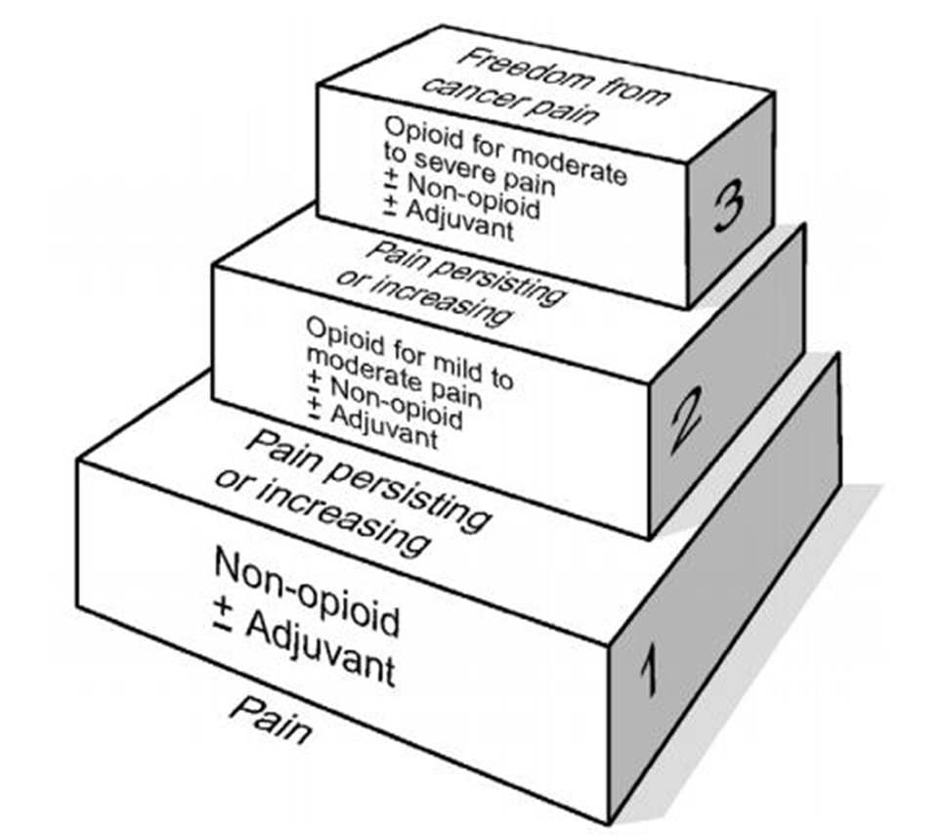
Pain Management WHO Analgesic Ladder
The World Health Organization’s goal is to manage pain without increasing the use of opioids. The ladder indicates how to alleviate pain without relying heavily on opioids. The guidelines focus on using adjuvants and non-opioid treatments.
World Health Organization (2015)

Slide 8
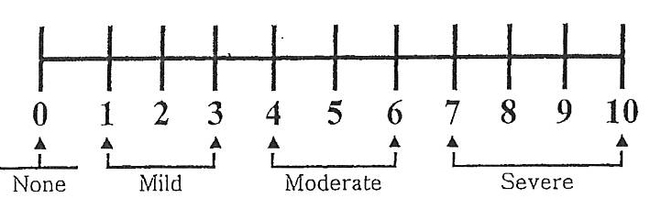
Practice Reminder
It is important to remember that pain medications are ordered for mild, moderate, severe, and breakthrough pain.

Slide 9
Ensure pain medications are only given for the appropriate/ordered indication.

Slide 10
Practice Reminder
Always ensure you are providing the appropriate pain medication ordered for the patient-reported pain rating.
Mild dose/type of pain medication is given when pain rating is 1-3.
Moderate dose/type of pain medication is given when pain rating is 4-6.
Highest dose/type of pain medication is given when pain is severe, rating is 7-10.

Slide 11
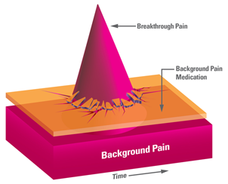
Practice Reminder Breakthrough Pain
Breakthrough pain occurs when a sharp spike or extra pain occurs after the patient receives a regularly scheduled medication or a PRN medication for mild, moderate, or severe pain.
Often a faster acting medication is used to treat breakthrough pain.
Remember, breakthrough pain medication is not given as initial treatment for report of mild, moderate, or severe pain.

Slide 12
Practice Reminder POSS Score
In addition to pain ratings RNs are required to do POSS scores to assess patients for level of sedation while receiving opioids (e.g. narcotics).
3 = frequently drowsy, arousable, drifts off to sleep during conversation (UNACCEPTABLE)
4 = somnolent (excessive sleepiness/hard to arouse), minimal or no response to verbal and physical stimulation (UNACCEPTABLE)
NOTE: Unacceptable criteria: notify prescriber; consider Rapid Response for a POSS score of 4!

Slide 13
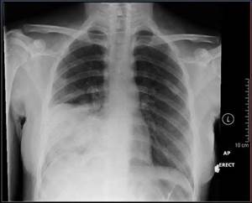
Case Study for Nurses
Ms. Jones: 68 y/o female admitted with SOB, productive cough, and fever. Chest X-ray is positive for pneumonia.
Abnormal Labs: WBC 20.4
Vitals: Temp. 101 F, Pulse 94, Resp. 24, BP 130/82
PMH: HTN, DM, Anxiety, Depression, Chronic back pain, Fibromyalgia, Osteoporosis

Slide 14
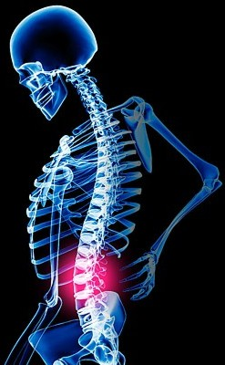
Upon arrival to the unit…
Ms. Jones is complaining of severe, 8/10, back pain…
She is asking for pain medication.
Which of the following plans would you expect to see from the patient’s provider?
A. Dilaudid 1mg IV x 1
B. Morphine 2mg IV x 1
C. Percocet (5mg/325mg) 1 tab. PO Q4 hr. PRN
D. Verify home medication regimen & restart
Click on the correct answer

Slide 15
Correct!
Verify home medications and restart.
The provider will further evaluate the patient’s pain, determine prior medication use and dose the patient appropriately.
IV pain medications are not indicated for chronic pain.
This patient lives with chronic pain and on a daily basis reports her pain to be a 7-8/10.
CLICK HERE TO PROCEED TO THE NEXT SLIDE

Slide 16
Incorrect
Please click here to go back to the question and try again.

Slide 17
Medication Reconciliation On admission
If opioid therapy is identified on admission, providers need to have answers to the following questions to determine the appropriate in-hospital pain medication orders:
How long has the patient been taking pain medications?
On average, how much medication does the patient take on a daily basis to manage pain?
Who prescribes the pain medication?
Ms. Jones’ Home Medication List:
Norvasc 5mg Daily
Multivitamin
Prilosec 20mg Daily
Paxil 20mg at HS
Dilaudid 4mg PO Q6 hr PRN

Slide 18
Daily patient update… Ms. Jones
Fevers persist and WBC’s remain elevated despite IV ABX. Her oxygen saturation decreases to the low 80s and she appears confused. Oxygen via NC is started.
Further work-up is ordered and in progress. The patient is now NPO for testing, which includes a Bronchoscopy.
She continues to complain of chronic back pain and is asking for pain medication.

Slide 19
Next step
Please select the order you would expect to receive for Ms. Jones.
A. Hold opioid therapy as patient is confused
with decreased oxygenation
B. IV Dilaudid PRN
C. Administer 0.4mg of Naloxone STAT
D. Oral Dilaudid 2mg Q6 hr PRN
Click on the correct answer

Slide 20
Correct!
It would be most appropriate to see Ms. Jone’s PO Dilaudid converted to IV in the hospital
The patient has been on PO Dilaudid for many years, opioids are not the cause of her respiratory/mental status changes.
Naloxone is not indicated at this time and starting dose should be 0.04mg in patients receiving opioid therapy to prevent total reversal/withdrawal.
Pt is NPO and with continued c/o pain, dose should not be decreased at this time.
CLICK HERE TO PROCEED TO THE NEXT SLIDE

Slide 21
Incorrect
Please click here to go back to the question and try again.

Slide 22
Take a moment to review Opioid Conversions Although providers are responsible for the ordering, it is important for nurses to understand opioid conversions so patients are not over- or under-dosed.
Medication | IV | PO
Morphine | 10 | 30
Hydrocodone (vicodin) |  | 30
Oxycodone |  | 20
Hydromorphone (Dilaudid) | 1.5 | 7.5
Fentanyl | 0.1
Oral 24hr Morphine Use (mg/day) | Fentanyl Patch Dose (mcg/hr)
60-134 | 25
135-224 | 50
225-314 | 75
315-404 | 100
405-494 | 125
495-584 | 150
585-674 | 175
675-764 | 200
24 Hour Oral Morphine Total | Oral Morphine : Methadone Ratio
<30mg | 2:1
31-99mg | 4:1
100-299mg | 8:1
300-499mg | 12:1
500-999mg | 15:1
>1000mg | 20:1
Notes:
Equi-analgesic charts are available online or through the pharmacy. *Green cards* see one of us for a green card

Slide 23
Opioid Conversion Calculation
Select the dose of IV Dilaudid that would be the most equivalent to Ms. Jones’ home regimen (Dilaudid 4mg PO):
A. Dilaudid 0.5mg IV Q6 hrs PRN
B. Dilaudid 1mg IV Q6 hrs PRN
C. Dilaudid 4mg IV Q6 hrs PRN
Click on the correct answer

Slide 24
Correct!
4mg of oral Dilaudid is most equivalent to 1mg IV Dilaudid
Exact Calculation:
1.5mg IV : 7.5mg PO :: X mg IV : 4mg PO
X = 0.8mg IV
CLICK HERE TO PROCEED TO THE NEXT SLIDE

Slide 25
Incorrect
Please click here to go back to the question and try again.

Slide 26
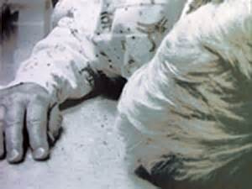
Work-up complete…
Ms. Jones has returned to her room post Bronchoscopy and appears drowsy yet comfortable. After a few hours, she ambulates to the bathroom, trips over her oxygen tubing, and falls. X-ray reveals a lumbar compression fracture.
She reports severe back pain. Pain is 10/10, sharp, stabbing with intermittent muscle spasms; decreases to a 7/10 after PRN Dilaudid which lasts for about 3 hours. She is restless and tearful.

Slide 27
Adjust the plan of care
Which of the following actions/orders would you expect to see from the provider based on Ms. Jones’ current status?
Current pain regimen: Dilaudid 1mg IV Q6 hrs PRN
A. Nothing as the patient is reporting some relief
B. An increase in the dose of the Dilaudid
C. An increase in the frequency of the Dilaudid
D. An increase in the dose and frequency of the Dilaudid
Click on the correct answer

Slide 28
Correct!
The dose and frequency should be increased.
Pain is now acute; expect higher opioid requirements in an opioid tolerant patient. Dosing interval should be every 3-4 hours, initially, until her pain is under control.
CLICK HERE TO PROCEED TO THE NEXT SLIDE

Slide 29
Incorrect
Please click here to go back to the question and try again.

Slide 30
Optimizing Pain Management
To attempt to optimize Ms. Jones’ pain management, adjunct medications are important. Which of the following would you suggest to the provider to improve her pain management regimen? Two of the following medications would be options, select one of the correct answers:
A. Tylenol 650mg Q6 hrs PRN
B. Tramadol 50mg Q6 hrs PRN
C. Scheduled Tylenol 650mg Q6 hrs
D. Gabapentin 100mg TID
E. Scheduled Robaxin 500mg Q6 hrs
Click on one of the correct answers

Slide 31
Correct!
Scheduled Tylenol and Robaxin are the correct answers. Administering medications on a schedule are more effective in treating pain.
Tramadol is contraindicated in this case as the patient is taking Paxil which increases the risk for Serotonin Syndrome.
Gabapentin is not indicated at this time since there is no neuropathic component identified.
CLICK HERE TO PROCEED TO THE NEXT SLIDE

Slide 32
Incorrect
Please click here to go back to the question and try again.

Slide 33
Ongoing Severe Pain…
Ms. Jones continues to complain of severe pain in her right leg and muscle spasms despite scheduled Tylenol, Robaxin, and PRN Dilaudid. She is restless in bed, has difficulty concentrating and sleeping.
Which of the following sets of orders would be most appropriate?
1. A, C, E, and G
Click on the correct answer, #1 or #2
2. A, B, D, and F
A. Continue Scheduled Tylenol
B. Continue IV Dilaudid PRN for breakthrough pain
C. Restart home dose of oral Dilaudid PRN
D. Increase home dose of Dilaudid to 6mg Q4 hrs PRN
E. Increase the Robaxin to 750mg Q6 hrs for spasms
F. Change the Robaxin to Valium 2mg PO Q8 hrs
G. Add Ambien at HS for sleep

Slide 34
Correct!
Continue the scheduled Tylenol and IV Dilaudid PRN. IV opioids are appropriate to continue for now as pain is not controlled.
Increase home Dilaudid to 6mg PO Q4 PRN
Change the Robaxin to Valium 2mg PO Q8 as anxiety is present on exam and will impact her pain control.
Incorrect actions include…
Restart home PO Dilaudid 4mg Q 6 PRN → Expect increases in baseline opioids with onset of acute pain.
Increase the Robaxin to 750mg Q6 → The current dose is not effective and anxiety is present.
Add Ambien at HS → This would increase the risk for side effects with opioids and benzodiazepines already on board; patient is not sleeping due to pain and anxiety; treat underlying cause.
CLICK HERE TO PROCEED TO THE NEXT SLIDE

Slide 35
Incorrect
Please click here to go back to the question and try again.

Slide 36
Pain Control Improving…
Over the next 24 hours, Ms. Jones’ spasms and anxiety improve. Pain is manageable with PRN Dilaudid but she continues to report end-of-dose failure. The provider decides to add a Sustained Release (SR) opioid to her regimen to optimize her level of function.
Prior to initiating SR opioid therapy in the acute care setting, the following need to be addressed…
Verify Insurance coverage (many require a prior authorization)
Consider cost
Identify out-patient follow up

Slide 37
Does Ms. Jones look like she is in pain?
Ms. Jones may not look like she is in pain because she is smiling… You may think she just wants to stay in bed and she sleeps a lot which is typical for an older person…
It is important to remember that we cannot “assume” what a patient is feeling… Nor can we judge how a patient feels by looking…
It is a common misperception that a person in pain “looks like” they are in pain. The reality is patients can be in pain even when they are smiling and engaging in normal conversation. A patient who is sleeping a lot may be using sleep as a coping mechanism to deal with the pain they are experiencing.
Always ask, don’t assume!

Slide 38
Scripting
To show that you care, can you identify some examples of what to say to Ms. Jones regarding her pain and pain management while she is in the hospital?
“I want to do all that I can to help with your pain and make you as comfortable as possible.”
or
“There may be some discomfort because of your condition; however we want to make you as comfortable as possible.”
Remember, even the things you say to a patient can affect a patient’s pain management (positively or negatively)!

Slide 39
Non-pharmacologic Pain Management Interventions
In addition to the medication orders, it is important to ask Ms. Jones what would help her to be more comfortable and help minimize her pain. There may be some non-pharmacologic interventions that you can do to help manage her pain.

Slide 40
Can you identify any non-pharmacologic pain management interventions?
Repositioning
Distraction
Conversation
Music
Appropriate use of humor
Imagery
Ask about pain in hourly rounds
Use of heat or cold
Breathing techniques
Temperature of room
Relaxation

Slide 41
Conclusion
If pain is not managed effectively, every aspect of the patient’s well being will be affected including eating, sleeping, and other activities of daily living.
Improving pain management focuses on a team approach while putting patients at the forefront of their care. Trust your patients, listen to their needs, be open and honest, and involve them in the decision making process and treatment plan.
You play a key role in managing a patient’s pain.

Slide 42
Thank you for completing the 2015 pain management education for nurses.
0.5 CE will be provided to nurses for successfully completing this program.
You can print a certificate of completion for your records once you have completed this program and associated posttest.
Completion of this program will be recorded automatically in the St. Luke’s EduTracker System once you have achieved 100% on the posttest.
Proceed to “Take Test”.
You can print a certificate of completion for your records once you have completed this program and understand the content.
Completion of this program will be recorded automatically in the St. Luke’s EduTracker System.
Please contact a member of the Network Pain PI Team with any questions.

