Slide 1
BEDSIDE SWALLOW SCREEN FOR DYSPHAGIA
Laura Cowen Ph.D. CCC-SLP
Speech Language Pathologist
Alanna Kearns RN, BSN, PN
Stroke Program Coordinator
July 2015

Slide 2
Objectives
The nurse will be able to identify which patient population requires a swallow screen before eating, drinking, or taking anything by mouth.
The nurse will be able to explain the rationale for having oral suction immediately available when doing a bedside swallow screen.
The nurse will be able to explain the difference between a swallow screen and a swallow evaluation.
The nurse will be able to recognize if the patient has passed the first section of the swallow screen.
The nurse will be able to explain how to safely administer a bedside swallow screen.

Slide 3
The Joint Commission & SBMC’s Requirement
All TIA and Stroke patients must have a swallow screen to identify dysphagia before receiving any oral intake for the first time including liquids, food and medications.
An MD order is not required to perform the Swallow Screen for Dysphagia.
Use the Swallow Screen for Dysphagia form in Cerner, found in Ad Hoc and click the green checkmark to save.
There should be a swallow screen performed on every TIA/stroke patient.

Slide 4
Swallow Screen vs. Bedside Swallow Evaluation
Swallow Screen
Bedside Swallow Evaluation
Performed by RN
Done automatically prior to any oral intake
Brief
Utilizes only water
Basic observation
Performed Speech Therapist
Done only with MD order
Can take 30-60 minutes
Utilizes full trial feed with multiple textures
Includes full oral and pharyngeal assessment

Slide 5
Procedures Performed by a Speech Therapist)
Bedside Swallow Evaluation (BSE)
Modified Barium Swallow Study (MBSS)
“Swallow evaluation”
“Swallow assessment”
“Bedside”
“Dysphagia evaluation”
“Video swallow”
“Swallow study”
“Videofluoroscopic Swallow study”
“Barium swallow with video”

Slide 6
Criteria for a Swallow Screen for Dysphagia
All Acute Ischemic Strokes (AIS)
All Hemorrhagic Strokes
All Transient Ischemic Attacks (TIA)

Slide 7
Other patients appropriate for swallow screen
Recently extubated patients
Head trauma patients
Any patient with recent neurological changes
Patients with neurodegenerative diseases
Patients with dementia
Recent cervical surgery patients
Patients that you feel are having swallowing difficulties

Slide 8
“To Do” List
Note: Only Registered Nurses who have completed this training may perform a Swallow Screen for Dysphagia
Only Nurses will perform this screening.
Have oral suction immediately available
See that the mouth is moist and clean. If not, provide oral care prior to doing the Swallow Screen for Dysphagia
Explain procedure to patient
Provide privacy
Provide patient teaching
Document patient’s response to Swallow Screen for Dysphagia
Save your work

Slide 9
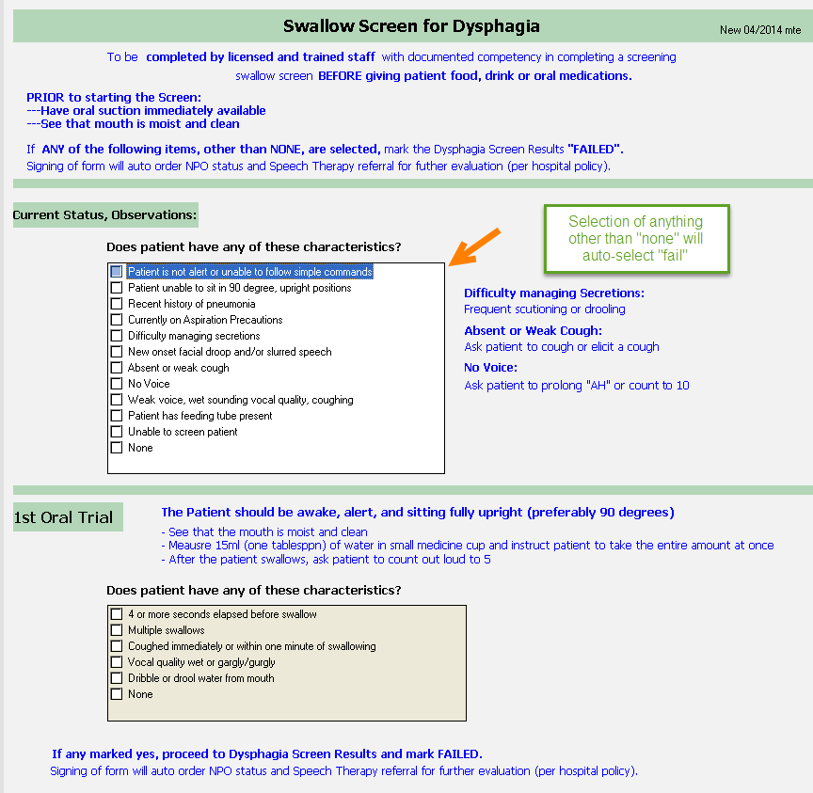
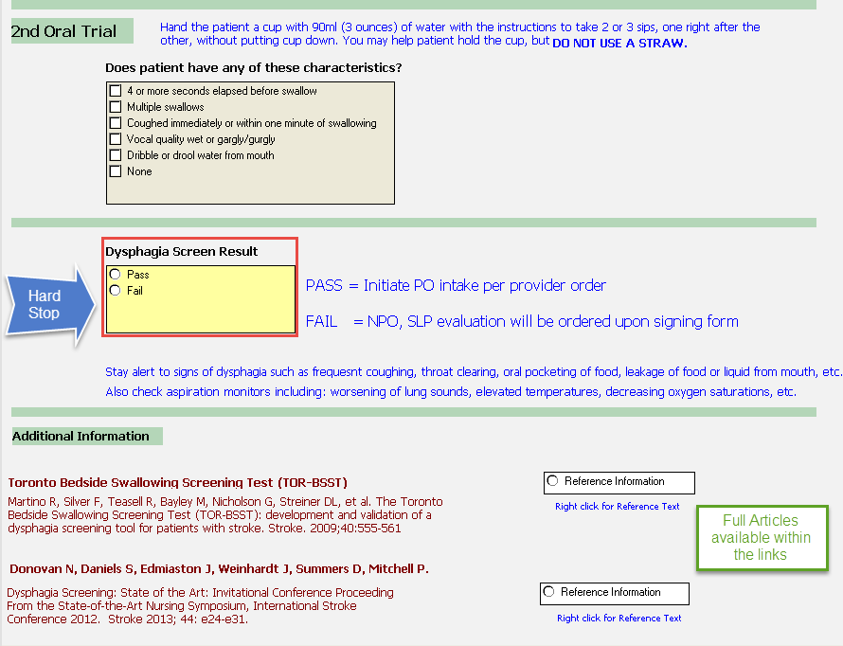
RN Swallow Screen
Chart this as a “Screen” not an “Evaluation”
Note that any
boxes checked in the top area is an automatic “Fail”
Keep the pt NPO
Nothing oral at all
A Swallow Evaluation by a Dysphagia Specialist will be automatically ordered if the patient fails this screen

Slide 10
“The Swallow Screen”
Current Status, Observations
Patient or family may give data
Can patient stay awake/follow simple commands?
History of recurrent or aspiration pneumonia?
Wet sounding voice?
Absent, weak or wet cough?
Difficulty managing secretions? (drooling or frequent suctioning)
Facial droop or slurred speech?
Feeding tube?
Difficulty swallowing when eating or drinking?

Slide 11
NPO except medications
All stroke and TIA patients that have orders for
“NPO except medications”
will be kept NPO
Until successfully passing a swallow screen
And having this documented in the electronic medical record

Slide 12
Swallow Screen (continued)
1st Oral Trial – 1 tablespoon water (15 ml)
2nd Oral Trial – 2-3 sips of water from cup (NO straws) (90 ml)
Did the water dribble or drool from patient’s mouth?
Did the patient swallow multiple times?
Did the patient cough immediately or within one minute after swallowing?
Did the patient’s vocal quality become wet or gurgly?

Slide 13
Swallow Screen Contraindications or Instant “Fail”
Patient unable to remain alert/awake without repeated stimulation
Inability to follow simple oral commands
Open mouth, stick out tongue, smile
Patient with existing feeding tube
Patient with respiratory difficulty, weak or absent cough, or recent history of aspiration pneumonia
Patient unable to sit upright at a 90 degree angle
Drooling with or without coughing
No voice

Slide 14
Results of the Screen
If ANY of the answers to the questions on the first part of the screen is anything other than “None”, the patient automatically FAILS the screen and needs to be kept NPO
A “ST BEDSIDE SWALLOW EVALUATION” will be ordered in Cerner.

Slide 15
If patient passes SCREEN and begins an oral diet…
Observe patient for any frequent coughing, throat clearing, choking, breathlessness, or wet/gurgly voice after drinking or eating.
Observe patient for oral pocketing of food and leakage of food or liquid from mouth.
Monitor aspiration indicators such as worsening lung sounds, elevated temperature and decreasing oxygen saturation.

Slide 16
If patient passes SCREEN and begins an oral diet…
Observe for worsening neurological condition and repeat SCREEN if worsening occurs.
Request a Nutrition Consult for inadequate hydration or nutritional intake.
Any concerns about swallowing, consult Physician about getting a “Bedside Swallow Evaluation by Speech Therapy”.

Slide 17
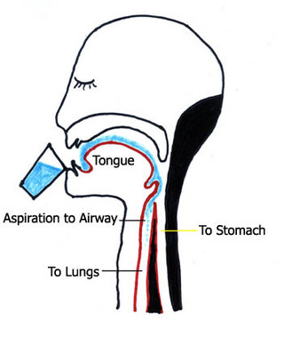
Swallow Screen: STK 7
Remember:
NO “NPO except Medications”!
Always check the swallowing!

Slide 18
Thank You

