Slide 1
Annual Update Section 8
Electronic Health Record (EHR)
Downtime Procedure

Slide 2
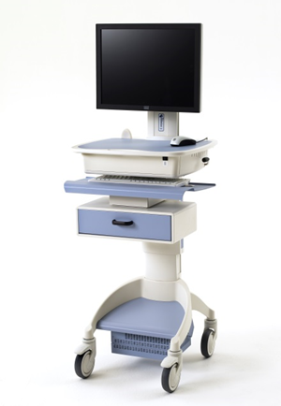
Downtime procedures are used for documenting patient care when the EHR is not available. The following information is an overview of downtime procedures. All clinical staff should be aware of the downtime policy PCS400130 Downtime Plan for Cerner and MedSeries 4 (MS4) and the Downtime Checklists for their area for more details.
There are two types of downtime; Planned and Unplanned.

Slide 3
Planned Downtime
Planned downtime is used when Dignity Health needs to make improvements and/or fixes to the EHR and/or hardware replacement. There are 3 phases to the planned downtime procedure. The first phase is Pre-Downtime. It starts 30 – 60 minutes prior to the planned downtime. During this time pharmacy will print paper MARs to each of the units. Nursing prints the following items on each of their patients and placed in thin chart to use as reference during downtime.
-Active Orders Report.
-All Tasks Report.
-Physician Rounding Report no meds.
-I and O Chronological 8 hour Report.
-Demographic labels (minimum of 10).
All this needs to be completed prior to the scheduled downtime. Downtime begins when you hear this overhead announcement, “Code Triage Internal, you then begin Cerner downtime procedures (If MS4 is also down, state as follows: begin Cerner and MS4 downtime procedures)”.

Slide 4
Planned Downtime
During downtime patient care orders are written on paper order sheets. Medication orders are scanned to the pharmacy. Lab and radiology orders are transcribed to a paper requisition and sent to the appropriate department. All stat orders and critical results are communicated by telephone to the appropriate person. All patient care is documented on the appropriate paper forms.

Slide 5
Reconciliation Phase
Reconciliation phase starts when the EHR comes up. There are several steps that take place during this time. Once the EHR is ready for use, there will be an overhead page stating “Code Triage Internal All Clear, downtime is over, please reconcile paper documentation and resume Cerner documentation.” NOTE: Do not log into Cerner until you hear the above announcement, then reconcile paper documentation and resume electronic documentation.

Slide 6
Reconciliation Phase
Each area has a process for reconciliation. Nursing should reconcile the following items:
Document new Patient Admission History, Order Entry Details, Valuables & Belongings via Ad Hoc PowerForms as appropriate.
Enter all patient care orders except lab, radiology and pharmacy orders
Document all medications and tasks completed during the downtime
Reconcile eMAR with the paper orders
Document I & O and the last set of vital signs from downtime documentation
Enter documentation that will drop charges i.e. Blood administration information, PCA/Epidural documentation as appropriate.

Slide 7
Unscheduled Downtime
Unscheduled downtime can happen anytime and is usually caused by a power outage or loss of internet connectivity. The processes are the same as the planned downtime except there is no time to print patient care information. To retrieve patient information, Cerner724 Downtime software is loaded on designated downtime computers. These computers are set up in all patient care areas and give staff access to the most the patient information prior to the interruption. Staff should know where these downtime computers are located in their area. Step by step instructions for accessing the 724 computer are located next to the computer. Staff will complete the Cerner 724 Access Log anytime they access the 724 downtime computer for patient information. The Cerner 724 downtime computers are only accessed in the event of an unscheduled downtime. Once the downtime is over, these audit logs will be collected and sent to the Facility Privacy officer.

