Slide 1
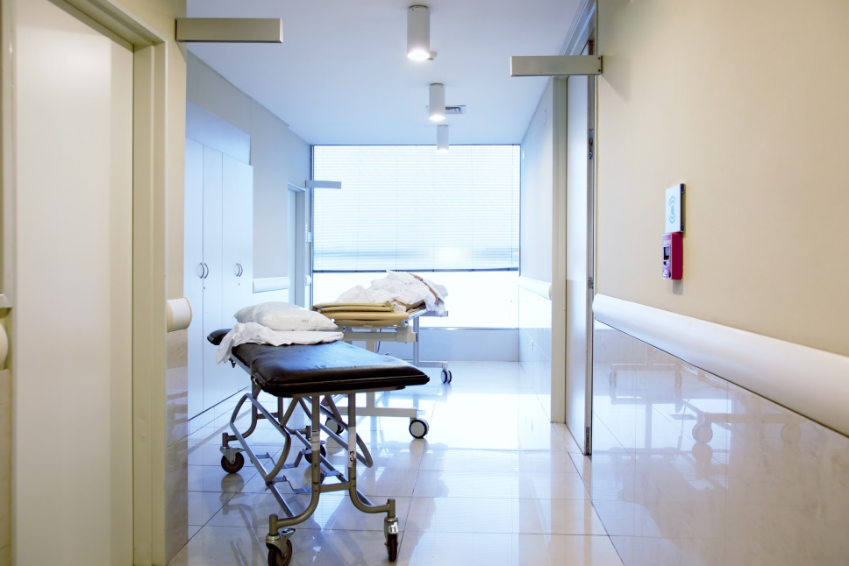
Environment of Care
Annual Update Section 2

Slide 2
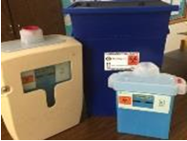






Environment of Care
The Environment of Care Team (EOC) provides a functional, safe, and effective environment for patients, staff and visitors.
Environment of Care | There are 6 areas included under the Environment of Care
The goal of the Environment of Care Program here at St. Bernardine Medical center is to provide a safe, functional and effective environment for patients, staff and visitors. We accomplish this goal through activities that: • Reduce and control the environmental hazards and risks • Prevent accidents and injuries • Maintain safe conditions for patients, staff and visitors.
Each facility has written plans and programs to design, implement, assess, evaluate and improve these areas. Each plan outlines activities that will reduce hazards in the workplace. The Environment of Care Committee is made up of employees like you.
Fire/Life Safety
EOC
Safety
Utility
Management
Security
Emergency
Management
Medical
Equipment
Hazardous Materials

Slide 3
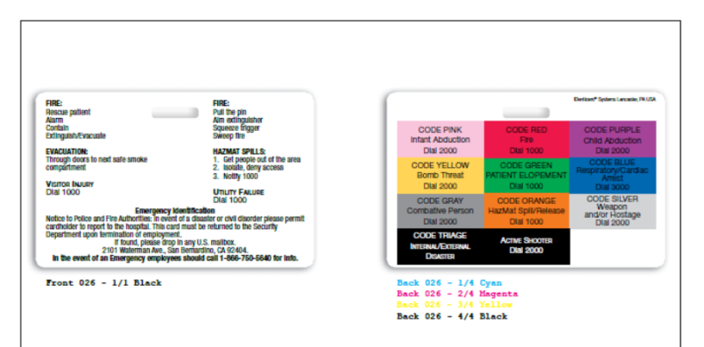
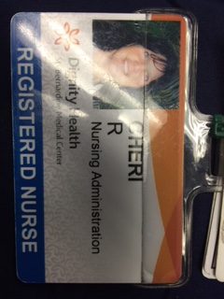

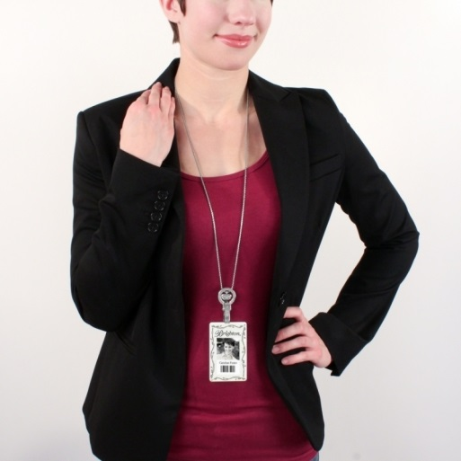
Badges
Upon hire, all SBMC employees are issued I.D. badges with a badge buddy. The badge buddy is designed to provide a quick reference for employees in an emergency. ID Badges must be worn at all times at “Eye Level” and must be worn with the picture and name facing front. Security should be contacted immediately to deactivate the badge if a badge is lost or stolen.
See HR for any lost or
Stolen ID badge replacement
Eye
Level
Not eye level

Slide 4

Employee Parking
1. Ride Share if applicable
2. Staff illegally parking on the campus may be subject to tow at their own expense.

Slide 5
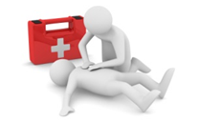
Medical Office Building
For any medical related assistance required in the Medical Office Building, the proper response would be to dial 911.

Slide 6

Pest Control
If you observe a pest or rodent on the campus please contact the Environmental Services Department by dialing 4430. EVS will contact the pest control vendor so that the affected area can be treated and monitored. Staff should be aware that leaving food of any kind unopened and unrefrigerated attracts both pest and rodents. See EVS policy G08000 online.

Slide 7
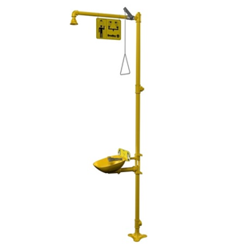

Eye Emergencies
Staff should be aware of the following symbols designating eye wash stations.
In the event an eye wash station is required the following procedure should be followed:
  Locate eye wash station (ED & Lab)
  Activate eye wash station by pushing the handle
  Flush eyes with fluid from the eye station continuously for 3-5 minutes

Slide 8
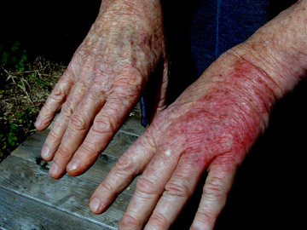
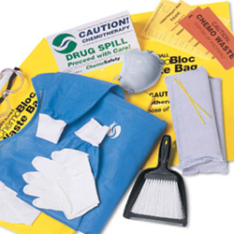
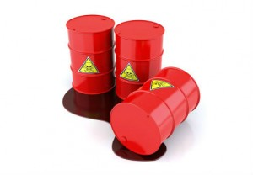
Hazardous Spills
In the event of a Hazardous spill, first call the operator by dialing 1000, “Code Orange” shall be used for all hazardous spills. Redirect all traffic away from the spill area, until the spill can be contained and mitigated.
Material Safety Data Sheets (MSDS)
In case of small spills—Act quickly, Contain the spill, Wear PPE, Notify proper personnel.
Hazardous Substances Spill Procedure—
  1. Remove anyone near the spill
  2. Isolate and deny access
  3. Notify PBX (dial 1000)
  4. Notify Hazmat company if it’s a large spill/Fire Department
Hazardous Material Tracking—Cradle to Grave tracking
MSDS is located on every computer in the hospital. It requires a sign-on: Login: bernardine Password: safety
Code Orange

Slide 9
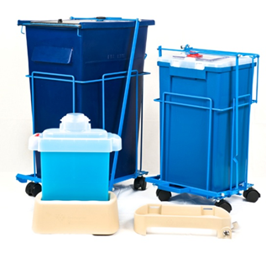
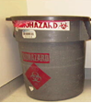
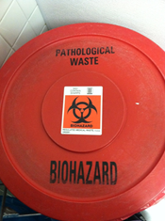
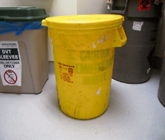
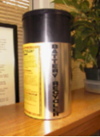
Hazardous Materials--
Know where to throw
Combined SHARPS & PHARMACY WASTE BIN
Needles, blades, scalpels, staples, guide wires, syringes. ALL IV BAGS (NOTHING IS DRAINED INTO THE SINK OR TOILET), vials that held medication (Ofirmev bottles/ mag citrate bottles)— Medication waste, residual or wasted narcotics, open/ unused meds such as capsules, tabs, suppositories
Have changed out when 2/3 full. Wall containers and free standing.
Never anything stored on top
Blood and body fluids, blood transfusion bag/tubings, bloody dressings.
Top of bin always snapped on firmly at all times
PATHOLOGICAL WASTE
Found in dirty utility. For tissue, specimen tubes with growth medium in it, items with isolizer.
Top of bin always snapped on firmly / nothing on top
CHEMO WASTE
All chemo, chemo tubings, syringes, gloves, masks, gowns, anything used to clean up chemo, anything used to clean the bodily fluids of a patient actively receiving chemo.
If you give a chemo drug PO, you must dispose of the bag it comes in on 5W in the chemo waste bin. Lid on tightly—never anything on top
ALL
BATTERIES

Slide 10

Radiation Safety
The presence and use of radiation in an open environment requires strict controls which are mandated by Federal and State laws. Compliance guidelines with safe handling and disposition of radioactive waste or materials must be strictly adhered to. Review the policy
For any questions relating to radiation exposures, please contact the Radiation Safety Officer ext. 7129 or the Nuclear Medicine Department at ext. 3653
Policy NM0070-Radioactive Waste Disposal

Slide 11





Emergency Codes
Code Orange
Internal Disaster—Hazardous Materials
  Hazardous substance spill
    Remove anyone near the spill
    Isolate and deny access
    Notify PBX (Dial 1000)
      Hazmat Company/Fire Department-see previous slide
Security Codes-extension 2911 or 2912
Combative person dial 2000
Weapon/Hostage dial 2000
Active Shooter dial 2000
Cardiac Arrest dial 3000
Code Gray
Code Silver
Code Black
Code Blue

Slide 12


Emergency Codes cont.
Code Pink
Infant Abduction dial 2000
Child Abduction dial 2000
Bomb Threat/phone threat dial 2000
Fire dial 1000
  Code Red is the appropriate hospital code when reporting a fire
  Fire drills are performed periodically to test all the systems involved in the fire safety program
  It is important to be familiar with all the emergency codes for SBMC
  Security can be reached by dialing 2911 for all emergency calls and 0 for all non-emergent call for service. Upon calling the operator please state your first name, last name and your department. The hospital operator will then locate and dispatch the closest officer to your location.
Code Red

Slide 13
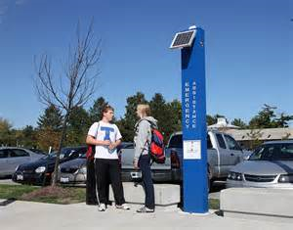
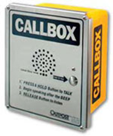
Emergency Call Boxes
Emergency call boxes are currently located in the parking structure and in the parking lots. If help is required please push the Red button on the call box. The hospital operator will be notified immediately and the nearest Security Officer will be dispatched to your location. The call boxes are Yellow and are located on each level of the parking structure.

Slide 14

Environment
All employees need to be aware of the surrounding environment inside and outside of the facility. ID badges are to be worn at all times. Vendors must display a Vendor mate badge. Report any suspicious activity to security immediately, by dialing 2911 or 2912. Security may also be reached outside of the facility by dialing (909)881-4580.

Slide 15
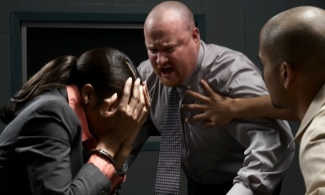


Workplace Violence
SBMC has ZERO tolerance for workplace violence. Any implied, actual threats or acts of violence should be reported immediately following the Chain of Command protocol.
Workplace violence is violence or the threat of violence against workers. It can occur at or outside the workplace and can range from threats and verbal abuse to physical assaults and homicide.
Alert supervisors to any concerns about safety or security and report all incidents immediately in writing.

Slide 16

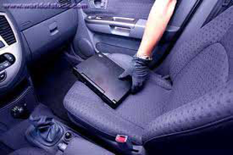
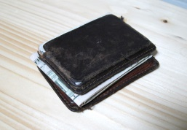
Employee Belongings
All employee personal belongings/valuables should be secured in a locked locker while on duty. High dollar items such as laptops, tablets and smart phones, should never be left unsecured or unattended. Employees will be held responsible for any lost items not secured while on SBMC property. Employees are encouraged to properly tag their personal belongings in case they are stolen and recovered.

Slide 17
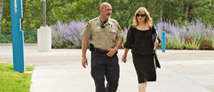
Safe Exit
Employees are encouraged to use the Security escort service 24 hours a day. Escorts may be provided by dialing Security at 2911 or 2912. For visitors and patients leaving at night, security asks that you call, so that an escort can be provided to our guests and patients as well. Security will be more than happy to assist you 24 hours a day, seven days a week.

Slide 18
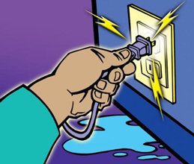
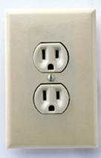
Electrical Information
When electrical equipment problems are identified, Tag the item, Lock it out of service, and call Engineering to report it. Do not use if safety sticker is outdated (see below for sample of Biomed Safety sticker). Any electrical equipment (for personal or patient use) brought from home to the hospital MUST BE CHECKED BY BIOMED before use. Call 3339.
Always use three-pronged (grounded) plugs. If you feel a "tingle or
shock," immediately Tagout/Lockout and report.
DO NOT USE! Any broken piece of equipment should be tagged
Tagout/Lockout and reported to Engineering immediately.
EMERGENCY POWER is provided by emergency generators during an
outage. Locate RED OUTLETS--these are the only outlets generated by the
emergency generator. All life-saving or life-sustaining equipment should be plugged
into a RED outlet. Know the location of flashlights and emergency extension cords. Use
electrical equipment properly and teach patients to do the same.
All new clinical equipment must be evaluated by clinical engineers from the Bio-Medical Department.
  Staff should review procedures for the proper use of equipment
  Immediately remove faulty equipment from service and tag it for repairs (Lock out/Tag out).
  Notify your supervisor if faulty equipment has caused serious harm to patients or employees
  Each piece of medical equipment is labeled with a inspection tag that should be checked each time, before the equipment is used. The tag itself will have the expiration date of when the equipment has to be re-inspected
  Bio Med staff can be reached by dialing extension 3347

Slide 19
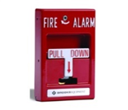
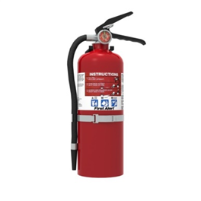
Fire Safety
All employees are required to comply with all fire policies:
  Know your department specific Fire/Emergency response plan
  Understand what to do in the event of a fire
  Know your responsibilities both for a fire in your area or in another part of the facility.
  Know where your nearest fire extinguisher is located on your unit
  Know where the closest fire pull station is location within your area.
  Know where the closest two evacuation routes are in your area.
Operate a fire extinguisher using the “PASS” method
  Pull the safety pin
  Aim at the base of the fire
  Squeeze the trigger
  Sweep back and forth

Slide 20
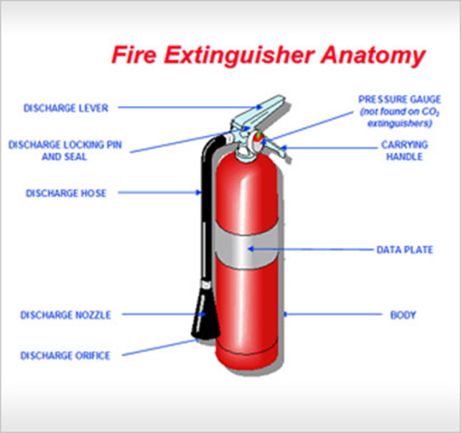
Fire Safety
When confronted with a fire, use the acronym RACE to remember the correct procedures to follow:
Rescue those in immediate danger
Alarm others in the area by activating the nearest fire alarm
Confine the fire and Call security
or your designated emergency contact
Extinguish the fire if small, or evacuate
During our recent CMC Survey staff were asked to recite PASS/RACE

Slide 21
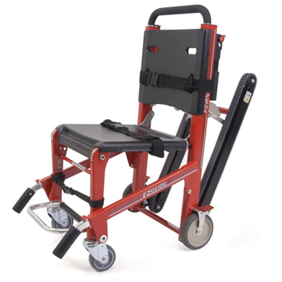
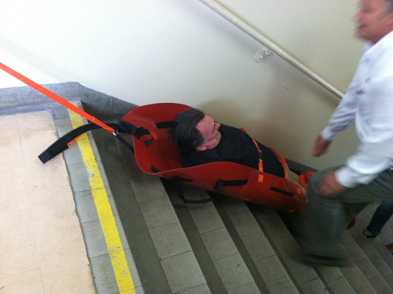
Fire Safety
Evacuation Chair:
  Primary function is to evacuate non-ambulatory patients down stairwells. Stored in Special cover they can hold a maximum weight of 500lb.
Para-slydes & Bara-slydes max weight 800lbs, require multiple staff to use.

Slide 22
Fire Watch
Fire Watch-what is that?
“Fire Watch” occurs when the fire alarm system is down for an extended time for repair
  Be on alert for smoke or fire
  Dial 1000

Slide 23

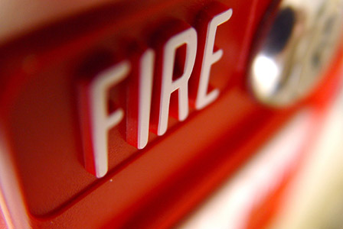
Fire Drills
Fire Drill-what to do in case of fire.
The operator announces, “Code Red Drill”
Respond as if it were a real fire, but do so Safely
Practice makes perfect
Once the drill is over the operator will announce, “Code Red, All Clear”

Slide 24
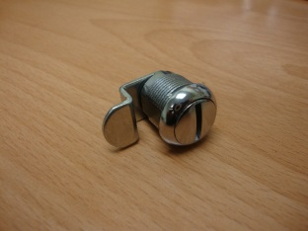
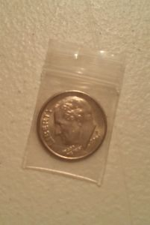
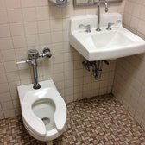
Unlocking Patient Restrooms
SBMC uses dime locks in all its patients’ bathrooms. The locks can be open by staff by using a dime in the slot on the outside door handle. A small key can also be utilized to open the door.
Common area restrooms may have a small chrome cap over the outside of the door and will require a hex key to open. Each nursing station should have a set of keys for accessing the restrooms in case of an emergency

Slide 25
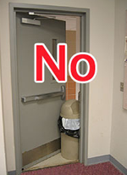
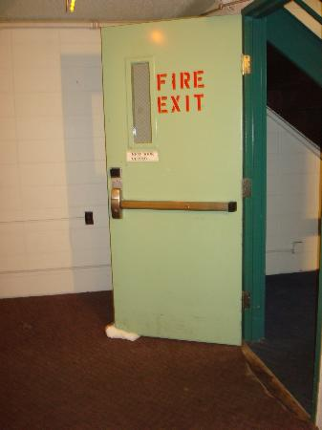
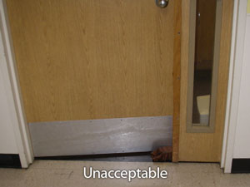
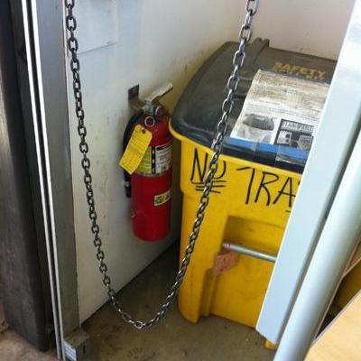
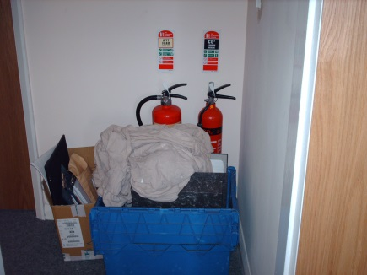
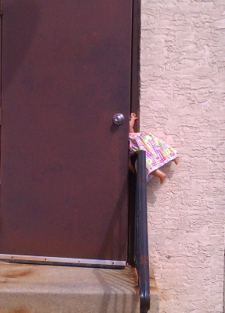
Doors and Access
DO NOT PROP DOORS OPEN
Don’t allow equipment or furniture to block exits or fire equipment

Slide 26


No Smoking Policy
SBMC is a smoke free campus
ADM policy 10810

Slide 27
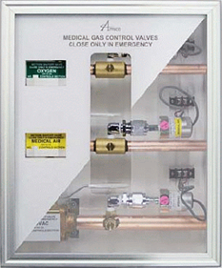
Red Outlets & O₂
Red Outlets—are covered by generators =
uninterrupted power in an emergency.
Staff is responsible for knowing the location of the oxygen shut off valves in their area, and
how to turn it off.

Slide 28



Work Safety
You have a right to a safe work place! Here are some things you can do to keep your work environment safe:
Know your job
Use good body mechanics
Work carefully and deliberately and be aware of your surroundings
Remain Alert; don’t take shortcuts
Report any unsafe conditions immediately!
Follow the Safe Patient Handling policy by using lift equipment when appropriate
Attend safety training and annual update training keep your work environment safe:
  Every hospital has an assigned Safety Officer. The Safety Officer is available to answer safety questions, provide training on safety topics and follow-up on safety issues impacting you in the workplace. Safety Officers are resources during facility audits and inspections.
SBMC Safety Officer Hospital Contact Number
Bud Rogers Extension #5068 pager 432-0091

Slide 29

Earthquakes
During an earthquake remain calm and seek immediate refuge under a desk and chair. Stay away from windows and be prepared for falling objects. Help patients or visitors to take the same precautions. NEVER run outside or use and elevator. DO NOT use the hospital phones for personal calls, this may reduce our ability to receive incoming, or make outgoing phone calls.
Flashlights- are available in every department. Locate the Emergency flashlights in your department.
REVIEW HICS LINK: http://www.emsa.ca.gov/HICS/forms.asp
THE LIFE YOU SAVE MAY BE YOURS OR YOUR FAMILY’S!

Slide 30

Safe Surrender
The Safely Surrendered Baby Law responds to the increasing number of newborn infant deaths due to abandonment in unsafe locations. First created in January 2001, the Safely Surrendered Baby Law was signed permanently into state law in January 2006. The law's intent is to save lives of newborn infants at risk of abandonment by encouraging parents or persons with lawful custody to safely surrender the infant within 72 hours of birth, with no questions asked. Safe surrender sites are hospitals or other locations, typically fire stations that are approved by the board of supervisors or fire agency in each county. Safe surrender sites are required to display the blue and white logo. The following is the toll-free telephone numbers for safe surrender sites in San Bernardino and Riverside County.

Slide 31

Safe Surrender
Dial 211
St Bernardine Medical Center employees can accept a surrendered baby from anywhere on the hospital grounds. Confidentiality must be maintained at ALL times.
What should I do if I am handed a baby:
  You must confirm that the parent is surrendering their infant to you
  Contact security who will escort you and the baby to the Emergency Department
  Once the infant is received, the child cannot be returned to the parent, either by request or with a change of mind
  The parent will be given a pamphlet on “Surrendering Parent Rights”
  If a parent attempts to surrender a baby to you outside of the hospital contact security at (909) 881-4580

Slide 32

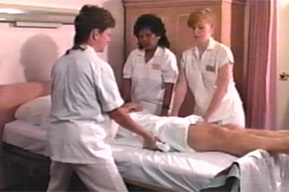

Ergonomics & Body Mechanics
  At work or at home, you perform many tasks that could potentially cause injuries. These include lifting, repetitive motions, prolonged sitting or standing, bending, reaching, pushing, pulling, carrying and turning. Use common sense and protect yourself from injuries. Most injuries are actually caused by the cumulative effect of the things we do every day.
The five major cumulative effects are:
      Stressful living & working habits
      Faulty body mechanics
      Poor posture
      Loss of flexibility
      Poor physical condition
The key to having a healthy back is maintaining good balance in your spine.

Slide 33
Ergonomics & Body Mechanics
SITTING—Sit close to your work, keeping elbows, hips and knees at 90 degree angles, put both feet flat on the floor, don't cross your legs, if typing or using a computer, adjust monitor so top if screen is at eye level and is at arm's length. Documents should be at same level as screen. Make sure your chair supports your lower back--use lumbar support if desired. Get up at least every hour and stretch or walk around for 3-5 minutes.
STANDING— Put one foot up and change positions often (30 mins.) when standing for long periods. Stand on a cushioned mat if possible. Wear comfortable shoes-no high heels. Keep repetitive work at a comfortable height, and keep feet apart for a good, balanced stance. Pivot, don't twist if stocking or loading items.
LIFTING— Assess before you lift. If you are unsure, get help. Establish a wide-balanced stance. Bend at your knees, not your back. Hold the load close. Lift smoothly and don't jerk. Tighten your abdominal muscles as you lift. Pivot, don't twist. If two or more people are lifting, establish a verbal signal before lifting and then lift in unison. Push or pull rather than lift. Pushing is better!

Slide 34

The Signs of Stroke

