Slide 1


Preeclampsia and Other Hypertensive Disorders of Pregnancy
Updates, Definitions and Treatment
Presented By:
Maternal Child Education
Notes:
Slide Deck intended for educational purposes across the Dignity Health organization

Slide 2

Session Objectives
Background Information – Maternal Morbidity and Mortality
Review of Preeclampsia Bundle Elements
Early Identification and Treatment
  Patient Assessment and Identification of Risk
  Standardized Treatment Guidelines
Patient Education and Early Discharge Follow-Up

Slide 3

CMQCC Releases Preeclampsia Toolkit 2014!
The California Maternal Quality Care Collaborative (CMQCC) released its toolkit for health care providers who care for women during the prenatal, birth and postpartum periods, Improving Health Care Response to Preeclampsia.
The complete toolkit is available on the CMQCC website (free of charge). For your convenience, the link is below:
https://www.cmqcc.org/preeclampsia_toolkit
Notes:
Toolkit Released– available for download on the CMQCC website

Slide 4
Background Information
Maternal Morbidity and Mortality

Slide 5


Maternal Mortality Rate, California Residents; 1970-2010
ICD-8 codes
ICD-9 codes
ICD-10 codes
Maternal Deaths per 100,000 Live Births
HP Objectives – Maternal Deaths (<42days postpartum) per 100,000 Live Births
SOURCE: State of California, Department of Public Health, California Birth and Death Statistical Master Files, 1970-2010. Maternal mortality for California (deaths ≤ 42 days postpartum) was calculated using the ICD-8 cause of death classification for 1970-1978, ICD-9 classification for 1979-1998 and ICD-10 classification for 1999-2010. Healthy People Objectives: HP2000: 5.0 deaths per 100,000 live births; HP2010: 3.3 deaths, later revised to 4.3 deaths per 100,000 live births, and; HP2020: 11.4 deaths per 100,000 live births. Produced by California Department of Public Health, Center for Family Health, Maternal, Child and Adolescent Health Division, December, 2012.
Notes:
Maternal mortality in California is increasing and is as high as it was in the 1970’s. Why is maternal mortality increasing?
Changes in the coding of maternal deaths on death certificates may account for some (i.e., 30%) of the increase (Hoyert, 2007)
In addition, more pregnant women have chronic health conditions that contribute to worse outcomes
Numerous social factors (poverty, reduced education, exposure to chronic stress)
Hospital quality of care and health care provider issues also contribute to some degree

Slide 6
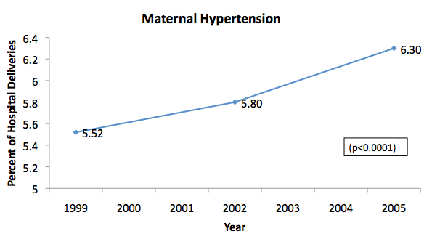
Maternal Hypertension in California, 1999-2005
All maternal hypertension identified at time of hospitalization for labor and delivery (includes pre-gestational and gestational hypertension)
Source: http://www.cdph.ca.gov/programs/mcah/Documents/MO-CAPAMR-TrendsinMaternalMorbidityinCalifornia-1999-2005-TechnicalReport.pdf
Notes:
Pregnancy with HTN in U.S. OB population=5-10% - Williams Obstetrics, 23rd Edition, 2009

Slide 7

Maternal Morbidity and Mortality: Preeclampsia
About 8 Preeclampsia Related Mortalities / Year in CA
Near Misses: 380/year (ICU admissions)
400-500x
40-50x
Serious
Morbidity: 3400/year (prolonged postpartum length of stay)
Source: 2007 All-California Rapid Cycle Maternal/Infant Database for CA Births
Notes:
Based on analysis of data in the All-California Rapid Cycle Maternal/Infant Database for California births in 2007 – the extent of morbidity associated with preeclampsia is shown in this slide.
There are approximately 8 deaths per year related to preeclampsia/eclampsia among CA women, but the rate of “near –miss” defined here as the number of ICU admissions is

Slide 8
CA-PAMR: Chance to Alter Outcome
Grouped Cause of Death; 2002-2004 (N=145)
Grouped Cause of Death | Chance to Alter Outcome
 | Strong / Good (%) | Some (%) | None (%) | Total N (%)
Obstetric hemorrhage | 69 | 25 | 6 | 16 (11)
Deep vein thrombosis/ pulmonary embolism | 53 | 40 | 7 | 15 (10)
Sepsis/infection | 50 | 40 | 10 | 10 (7)
Preeclampsia/eclampsia | 50 | 50 | 0 | 25 (17)
Cardiomyopathy and other cardiovascular causes | 25 | 61 | 14 | 28 (19)
Cerebral vascular accident | 22 | 0 | 78 | 9 (6)
Amniotic fluid embolism | 0 | 87 | 13 | 15 (10)
All other causes of death | 46 | 46 | 8 | 26 (18)
Total (%) | 40 | 48 | 12 | 145
Notes:
TALKING POINTS: -
CA PAMR Committee judged that there was a strong-to-good chance to have altered the fatal outcome in 50% of the pregnancy-related deaths in California in 2002 to 2004.
12 of the 24 cases of preeclampsia (50%) had a good–to-strong chance to alter outcome.
In comparison, none of the 15 deaths from amniotic fluid embolism had a good-to-strong chance to alter outcome.
Of the 57 (40%) cases with a good-to-strong chance to alter the outcome, the Committee determined that healthcare professional factors contributed to the fatal outcome in X deaths (X%), facility factors contributed to the fatal outcome in X (X %) cases, and patient factors contributed to the fatal outcome in X (X%) cases.
Data Source: CA PAMR, Pregnancy-Related Deaths; 2002-2004 (N=145)

Slide 9
Severe Preeclampsia Case Studies

Slide 10

Patient A – “Molly”
Molly is an 18-year old primigravida who presents to Hospital A (Level 1, community hospital) L&D at 32 1/7 weeks gestation
Chief Complaint – Headache
Initial Assessment
  VS – HR 92, BP 176/118 (repeated 172/116), RR 20, T wnl
  FHR – Baseline 140’s, Mod Variability, + accels, no decels

Slide 11
Patient A – “Molly”
MD notified and orders given for Tylenol and “PIH labs”
BPs assessed frequently (q 15 minutes)
  162/112, 158/108, 172/118
Patient continues to complain of headache and new onset visual changes
MD notified for persistently elevated BP’s and change in status - orders for IV Hydralazine and Magnesium Sulfate
Maternal Fetal Medicine consult
Lab results received and consistent with HELLP syndrome
IV Hydralazine given x1 and Magnesium Sulfate initiated
Patient transferred to a higher level of care

Slide 12
Patient A – “Molly”
Upon arrival at tertiary center, patient evaluated:
  BP’s – 182/115, 178/114, 170/110
  Repeat labs confirmed HELLP syndrome
Eclamptic Seizure in L&D, followed by fetal bradycardia and emergency cesarean section
After the procedure, the patient was somnolent and transferred to ICU
Infant Outcome – Baby Boy, weighed 2325 gm, Apgars 3, 7, 8 and transferred to the NICU for prematurity
Maternal Outcome – head CT confirmed intracranial hemorrhage (stroke), patient in ICU for 19 days with multiple procedures (including craniotomy). Transferred to Acute Rehab with moderate neurological deficits.

Slide 13
Patient B – “Rosalie”
Rosalie is an 26-year old G2P1 who presents to L&D at 31 1/7 weeks gestation. Risk factors – obesity, gestational diabetes.
Chief Complaint – Headache and “seeing spots”
Initial Assessment
  VS – HR 98, BP 190/116 (repeated 184/110), RR 22, T wnl
  FHR – Baseline 145, Mod Variability, + accels, no decels

Slide 14
Patient B – “Rosalie”
MD notified and the following orders
  IV Labetalol and IV Hydralazine
  Magnesium Sulfate
  PO Nifedipine XL 30mg
  PIH Labs and 24 hour urine
  Antenatal Steriods
BPs assessed frequently (q 15 minutes)
  162/112, 158/108, 172/118
Lab results received and within normal
24 hour urine = 8.5 gm protein
Patient admitted to high-risk antepartum unit
  BP’s 140/90, 148/92, 155/100 …
  Headache resolved

Slide 15
Patient B – “Rosalie”
On day 3 of patient’s stay
  BP’s increasing – 162/98, 168/102 …
  New onset headache, blurry vision, nausea/vomiting
Cesarean delivery for Breech and Preeclampsia with severe features
Infant Outcome – Baby Boy, weighed 2560 gm, Apgars 6,9 and transferred to the NICU for prematurity
Maternal Outcome – Postoperative stay within normal, Magnesium Sulfate continued for 24 hours post-delivery and discharged home on post-op day 4.

Slide 16
Preeclampsia Bundle Elements

Slide 17
Dignity Health’s Preeclampsia Bundle Elements
Early detection
Treatment with IV antihypertensives
Magnesium Sulfate for seizure prophylaxis
Follow-up
Pt education

Slide 18
Classification of Hypertensive Disorders of Pregnancy
Preeclampsia/Eclampsia – Hypertension in association with new onset proteinuria OR ANY new onset systemic findings such as thrombocytopenia, impaired liver function, renal insufficiency, pulmonary edema or cerebral/visual changes
Chronic HTN – HTN that predates pregnancy
Chronic HTN with Superimposed Preeclampsia
Gestational HTN – BP elevation after 20 weeks gestation in the absence of proteinuria or any systemic involvement

Slide 19
Blood Pressure Criteria for Preeclampsia
Blood pressure greater than or equal to 140 mm Hg systolic or greater than or equal to 90 mm Hg diastolic on two occasions at least 4 hours apart after 20 weeks of gestation in a woman with previously normal BPs.
Blood pressure greater than or equal to 160 mm Hg systolic or greater than or equal to 110 mm Hg diastolic, hypertension can be confirmed in a short time interval of 15 minutes to facilitate timely treatment with antihypertensive therapy.
ACOG (Nov 2013) Hypertension in Pregnancy; Executive Summary. Obstetrics & Gynecology Vol. 122 No. 5

Slide 20
What’s New … Preeclampsia Definitions
Proteinuria will NOT be a requirement to diagnose preeclampsia with new onset hypertension.
The term “Mild Preeclampsia” will be eliminated as preeclampsia is multisystemic in nature and is both dynamic and progressive.
New definitions of Preeclampsia will include Preeclampsia with or without “Severe Features”

Slide 21
Severe Features of Preeclampsia (Any of these findings)
Systolic blood pressure of 160 mm Hg or higher, or diastolic blood pressure of 110 mm Hg or higher on two occasions at least 4 hours apart while the patient is on bed rest (unless antihypertensive therapy is initiated before this time.
Thrombocytopenia (platelet count less than 100,000/microliter
Impaired liver function as indicated by elevated liver enzymes and/or severe persistent right upper quadrant pain
Progressive renal insufficiency
Pulmonary edema
New onset cerebral of visual disturbances
ACOG (Nov 2013) Hypertension in Pregnancy; Executive Summary. Obstetrics & Gynecology Vol. 122 No. 5

Slide 22
Early Identification and Treatment

Slide 23
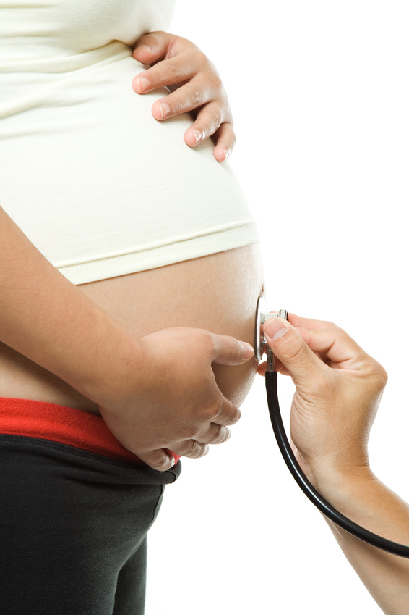
Key Clinical Pearl
Controlling blood pressure
is the optimal intervention
to prevent deaths due to stroke
in women with preeclampsia

Slide 24

Identification of Persistently Elevated Blood Pressures
Systolic BP of > 160 mm Hg OR
Diastolic BP of > 110 mm Hg
At least two repeated measurements over a 15 minute window
When an elevated BP is present, be sure to set your automated machines to repeat the BP at a minimum of every 15 min in order to correctly identify persistent hypertension!

Slide 25
Improving Accuracy in Blood Pressure Measurement
Automated blood pressure machines tend to underestimate systolic and diastolic readings by as much as 10mm Hg
When a patient’s blood pressure or treatment options are questionable, always confirm with manual blood pressure readings.
Position – Patient should be seated in the semi-fowlers or high fowlers position with her back supported and legs uncrossed
Do not mask a patient’s true blood pressure by lowering the head of the bed or placing the patient on the left side.

Slide 26
Improving Accuracy in Blood Pressure Measurement
Cuff Placement – The BP cuff should be placed with the bladder over the brachial plexus artery pulsation (upper arm unless contraindicated)
Patient should sit quietly for 5 minutes before measurement
BP measurements can be influenced by food intake, smoking, caffeine, cold air, pain and headache. Do not alter your treatment plan based on any of these variables.

Slide 27
Treatment Medications
IV Labetalol or IV Hydralazine are both considered first-line medications for the management of acute-onset, severe hypertension in pregnant and postpartum women.
Magnesium sulfate is NOT recommended as an antihypertensive agent, but is still used for eclampsia prevention as clinically indicated.

Slide 28
Treatment Medications
IV antihypertensive medications need to be administered slowly over a two minute timeframe.
IV tubing should be flushed slowly to prevent any medication from being retained in the IV ports used on the tubing.
SaO2 monitoring is mandatory for continuous assessment of maternal heart rate.

Slide 29
Treatment Timeframe
IV Labetalol or IV Hydralazine should be administered within 30-60 minutes from the confirming blood pressure reading
If IV access is not available, PO Nifedipine is the only approved PO drug due to its rapid onset of action of 20 minutes.
Target BP levels are between 120-160 mm Hg systolic and 80-105 mm Hg diastolic

Slide 30
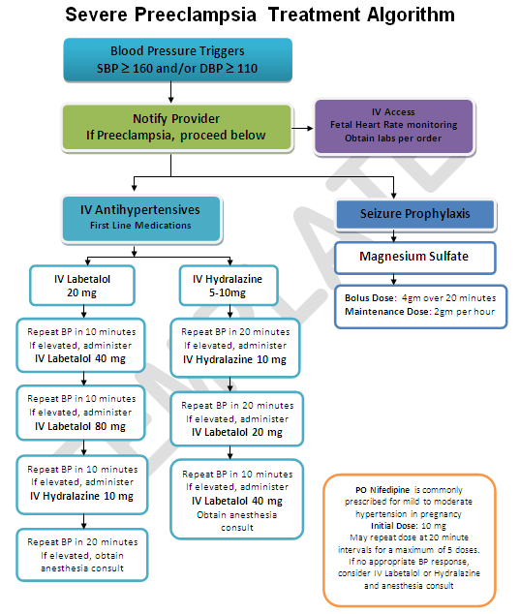
Severe Preeclampsia Algorithm

Slide 31
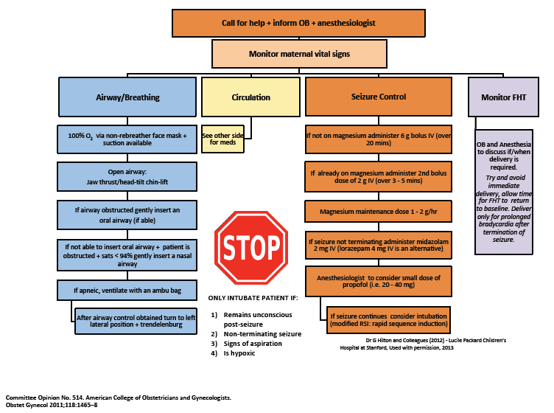

Eclampsia Management Algorithm

Slide 32
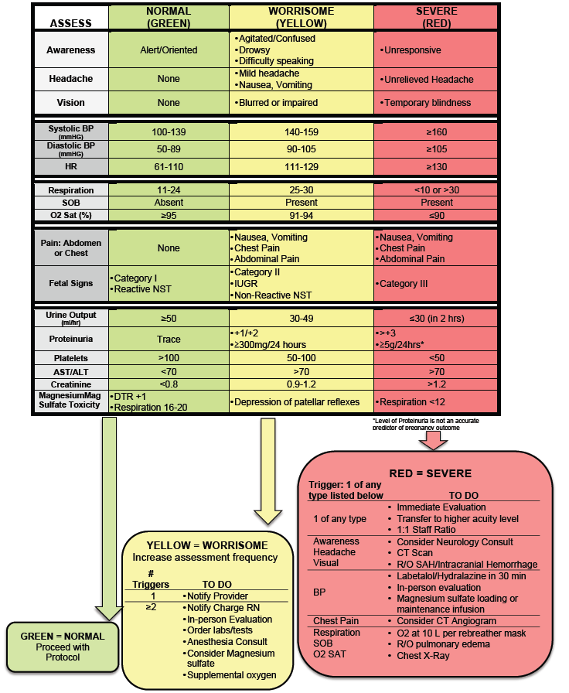
Preeclampsia Early Recognition Tool

Slide 33
Patient Education and Early Discharge Follow-Up

Slide 34
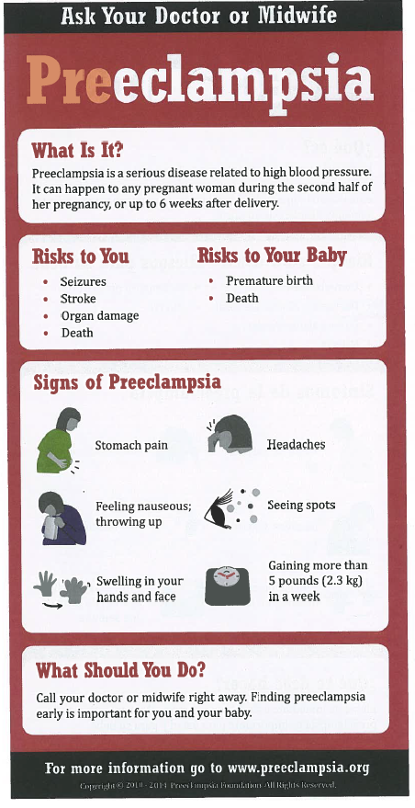
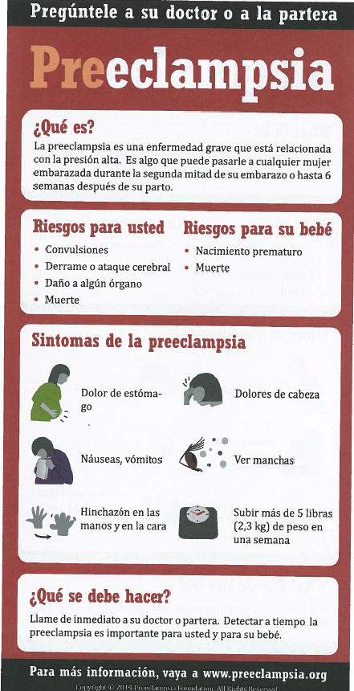
Patient Education Materials
Preeclampsia Foundation example
Other patient education materials can be ordered from www.preeclampsia.org/market-place

Slide 35
Early Post Discharge Follow-up
All patients diagnosed with preeclampsia/eclampsia
Preeclampsia Toolkit recommends follow-up
  within 3-7 days if medication was used during labor and delivery OR postpartum
  within 7-14 days if no medication was used
Postpartum patients presenting to the ED with hypertension, preeclampsia or eclampsia should either be assessed by or admitted to an obstetrical service

Slide 36
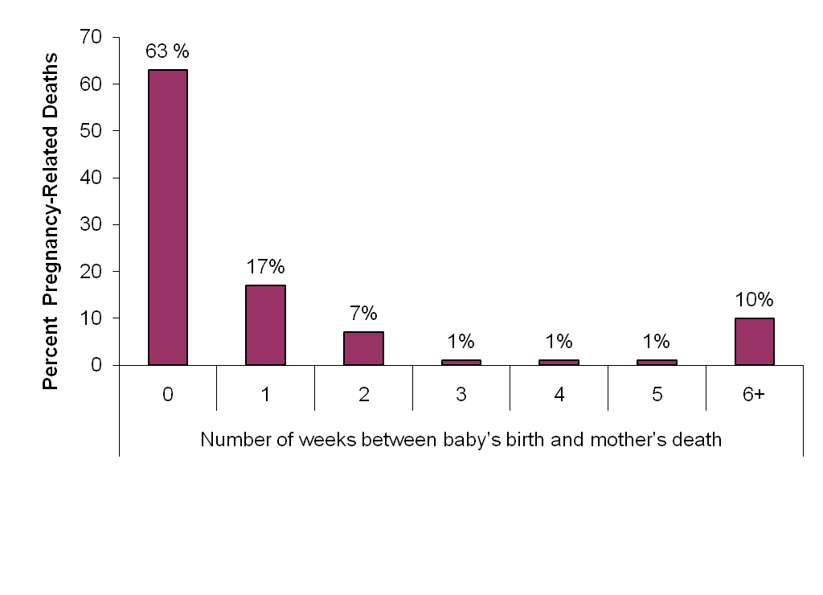
Timing of Pregnancy-Related Deaths
CA-PAMR, 2002 to 2004
89%
Non-Preeclampsia Deaths
87%
96%
Preeclampsia Deaths
88%
Additional cases presented postpartum- 68% occurred within 4 days of delivery
Notes:
Preeclampsia and non-preeclampsia cases have about the same number of deaths in the 2 week postpartum periods so targeting early follow-up for preeclampsia should help to address this group of patients.
It is important to recognize that additional cases presented postpartum. Of the 25 cases of deaths from PE, 17/25 (68%) occurred within 4 days of delivery. All but 1 occurred within 42 days of delivery.

Slide 37
For More Information and to
Download the CMQCC Toolkit
Visit the CMQCC website: www.cmqcc.org
Or contact info@cmqcc.org

Slide 38

Thank you for your time and effort!
Notes:
This data can not be distributed outside of Dignity Health or for other presentations

