Slide 1
It is ALL About the Patient

Slide 2
Objectives
At the end of the of the class, the participants will be able to:
Define a plan of care and identify its characteristics and elements
Develop a plan of care utilizing nursing diagnosis based on the nursing process
Write SMART objectives and formulate hypothesis
Individualize the plan of care by selecting appropriate interventions and prioritizing nursing diagnoses
Formulate nursing care plan based on the scenarios provided

Slide 3
INTRODUCTION: Understanding the Plan of Care

Slide 4
Definition
The Plan of Care
Is a set of actions the nurse will implement to resolve or support the nursing diagnosis as identified by the nursing assessment.
It outlines the nursing care to be provided to a patient and guides in the ongoing provision of care and assists in the evaluation of that care.

Slide 5
Elements
The Plan of Care
Consists of a nursing diagnosis with defining characteristics (subjective and objective data that support the diagnosis), relate factors or risk factors, expected outcomes/goals and nursing interventions.
Also known as the Nursing Process

Slide 6
Premise of the Nursing Process
Based upon the scientific method:
State an observed problem
Form a hypothesis about the problem
Develop a method to test the hypothesis
Collect the data
Analyze the data
Draw conclusions about the hypothesis

Slide 7
Characteristics
The Plan of Care
Its focus is holistic and is based on the clinical judgment of the nurse, using assessment data collected from a nursing framework
It is based upon identifiable nursing diagnosis (actual, risk or health promotion) --- clinical judgments about individual, family, or community experiences or responses to actual or potential health problems or life processes
It focuses on client-specific nursing outcomes that are realistic for the care recipient.
It includes nursing interventions which are focused on the etiologic or risk factors of the identified nursing diagnosis.
It is a product of a deliberate systemic process.
It relates to the future.

Slide 8
Purpose of Plan of Care
Plan of Care provide direction for individualized care of the patient and provides a “road map” of sorts to guide all who are involved in the patient’s care.
A plan of care flows from each patient’s unique list of diagnoses and should be organized by the individual’s specific needs.
Plan of care provide continuity of care
The plan of care is a means of communicating and organizing the actions of a constantly changing nursing staff
As the patient’s needs are attended to, the updated plan of care is passed on to the nursing staff at shift change and during nursing rounds

Slide 9
Purpose of Plan of Care
Plan of Care help teach documentation.
The plan of care should specifically outline which observations to make, what nursing actions to carry out, and what instructions the client or family members require.
Plan of Care serve as a guide for assigning staff to care for the client.
There may be aspects of the patient’s care that need to be assigned to team members with specific skills
Plan of Care serve as a guide for reimbursement
The medical record is used by the insurance companies to determine what they will pay in relation to the hospital care received by the client. If the nursing care was not documented precisely in the care plan, there is no proof the care was provided and insurers will not pay for what is not documented.

Slide 10
Components of Plan of Care
Nursing Diagnosis
Outcomes Identification
Goals
Objectives
Intervention
Evaluation

Slide 11
CHSB Plan of Care

Slide 12
Who Activates the Plan of Care
The Plan of Care must be activated by the RN who completes the admission assessment
The plan of care is based upon nursing assessment of patient needs. From this assessment evolves the formation of nursing diagnosis, expected patient outcomes/goals and related nursing interventions.
Each patient must have at least one identified knowledge deficit nursing diagnosis addressed during the hospital stay
The RN must create an individualized plan of care based on medical diagnosis and patient’s needs
The plan of care is generated in Meditech

Slide 13
Who Is/Are Involved in Plan of Care
The plan of care is an interdisciplinary process which includes:
Patient
Physician
Nurse
Patient Representative/
Family Member
Case Manager

Slide 14
The Nursing Process:

Slide 15
Nursing Process
Clinical Nursing Practice Standards define the nursing process within the context of six standards of care:

Slide 16
Nursing Process - cont’d.
Standard I : Assessment
- Collects, organizes and synthesizes pertinent data using evidence-based assessment techniques.
Standard II : Nursing Diagnosis
- Identifies problems in order of priority and formulates a nursing diagnosis defined by the collected data/information.
Standard III : Outcomes Identification
- Constructs outcomes that are realistic, measurable, with time limited goals ( short and long term).

Slide 17
Nursing Process - cont’d.
Standard IV : Planning
- Develops personalized plan of care using strategies/alternatives to attain expected Outcome(s).
Standard V : Implementation
- Implements the plan safely using evidence-based interventions/treatments.
Standard VI : Evaluation
- Performs on-going evaluation of desired outcomes and documents results of evaluation.

Slide 18
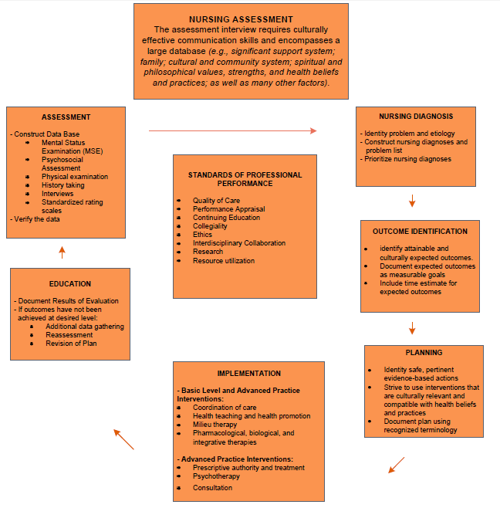
The Nursing Process Diagram

Slide 19
How the Nursing Process Applies to the Scientific Method
Scientific method | Nursing process
State an observed problem | Assessment
Form a hypothesis about the problem | Nursing diagnosis
Develop a method to test the hypothesis | Outcome Identification and Planning
Collect the data Analyze the data | Implementation
Draw conclusions about the hypothesis | Evaluation

Slide 20
NANDA Nursing Diagnosis
NANDA Nursing diagnosis based on alphabetical order A:
Activity Intolerance Activity Intolerance, risk for Airway Clearance, ineffective Allergy Response, latex Allergy response, latex, risk for Anxiety [specify level] Anxiety, death Aspiration, risk for Attachment, risk for impaired parent/infant/child Autonomic Dysreflexia Autonomic Dysreflexia, risk for
NANDA Nursing diagnosis based on alphabetical order B:
Blood Glucose, risk for unstable Body Image, disturbed Body Temperature, risk for imbalanced Bowel Incontinence Breastfeeding, effective Breastfeeding, ineffective Breastfeeding, interrupted Breathing Pattern, ineffective
NANDA Nursing diagnosis based on alphabetical order C:
Cardiac Output, decreased Caregiver Role Strain Caregiver Role Strain, risk for Comfort, readiness for enhanced Communication, impaired verbal Communication, readiness for enhanced Conflict, parental role Confusion, acute Confusion, risk for acute Confusion, chronic Constipation Constipation, perceived Constipation, risk for Contamination Contamination, risk for Coping, defensive Coping, ineffective Coping, readiness for enhanced Coping, ineffective community Coping, readiness for enhanced community Coping, compromised family Coping, disabled family Coping, readiness for enhanced family

Slide 21
NANDA Nursing Diagnosis
NANDA Nursing diagnosis based on alphabetical order D:
Death Syndrome, risk for sudden infant Decisional Conflict (specify) Denial, ineffective Dentition, impaired Decision-Making, readiness for enhanced Development, risk for delayed Diarrhea Disuse Syndrome, risk for Diversional Activity, deficient
NANDA Nursing diagnosis based on alphabetical order E:
Energy Field, disturbed (revised)
Environmental Interpretation Syndrome, impaired
NANDA Nursing diagnosis based on alphabetical order F:
Failure to Thrive, adult Falls, risk for Family Processes: alcoholism, dysfunctional Family Processes, interrupted Family Processes, readiness for enhanced Fatigue Fear (specify focus) Fluid Balance, readiness for enhanced Fluid Volume, deficient Fluid Volume, excess Fluid Volume, risk for deficient Fluid Volume, risk for imbalanced
NANDA Nursing diagnosis based on alphabetical order G:
Gas Exchange, impaired Glucose, risk for unstable level Grieving Grieving, complicated Grieving, risk for complicated Growth, risk for disproportionate Growth & Development, delayed

Slide 22
NANDA Nursing Diagnosis
NANDA Nursing diagnosis based on alphabetical order H:
Health Behavior, risk prone Health Maintenance, ineffective Health-Seeking Behaviors (specify) Home Maintenance, impaired Hope, readiness for enhanced Hopelessness Human Dignity, risk for compromised Hyperthermia Hypothermia
NANDA Nursing diagnosis based on alphabetical order I:
Identity, disturbed personal Immunization Status, readiness for enhanced Infant Behavior, disorganized Infant Behavior, organized, readiness for enhanced Infant Behavior, risk for disorganized Infant Feeding Pattern, ineffective Infection, risk for Injury, risk for Injury, risk for perioperative positioning Insomnia Intracranial Adaptive Capacity, decreased
NANDA Nursing diagnosis based on alphabetical order K:
Knowledge, deficient Knowledge, readiness for enhanced
NANDA Nursing diagnosis based on alphabetical order L:
Lifestyle, sedentary Liver Function, risk for impaired Loneliness, risk for
NANDA Nursing diagnosis based on alphabetical order M:
Memory, impaired Mobility, impaired bed Mobility, impaired physical Mobility, impaired wheelchair Moral Distress

Slide 23
NANDA Nursing Diagnosis
NANDA Nursing diagnosis based on alphabetical order N:
Nausea Noncompliance Nutrition, less than body requirements, imbalanced Nutrition, more than body requirements, imbalanced Nutrition, readiness for enhanced Nutrition, more than body requirements, risk for imbalanced
NANDA Nursing diagnosis based on alphabetical order O:
Oral Mucous Membrane, impaired
NANDA Nursing diagnosis based on alphabetical order P:
Pain, acute Pain, chronic Parenting, impaired Parenting, readiness for enhanced Parenting, risk for impaired Perioperative Positioning, risk for
Peripheral Neurovascular Dysfunction, risk for Poisoning, risk for Post-Trauma Syndrome Post-Trauma Syndrome, risk for Power, readiness for enhanced Powerlessness Powerlessness, risk for Protection, ineffective
NANDA Nursing diagnosis based on alphabetical order R:
Rape-Trauma Syndrome Rape-Trauma Syndrome: compound reaction Rape-Trauma Syndrome: silent reaction Religiosity, impaired Religiosity, risk for impaired Religiosity, readiness for enhanced Relocation Stress Syndrome Relocation Stress Syndrome, risk for Role Performance, ineffective

Slide 24
NANDA Nursing Diagnosis
NANDA Nursing diagnosis based on alphabetical order S:
Self-Care Deficit: bathing/hygiene Self-Care Deficit: dressing/grooming Self-Care Deficit: feeding Self-Care Deficit: toileting Self-Care, readiness for enhanced Self-Concept, readiness for enhanced Self-Esteem, chronic low Self-Esteem, situational low Self-Esteem, risk for situational low Self-Mutilation Self-Mutilation, risk for
Sensory Perception, disturbed: (specify: visual, auditory, kinesthetic, gustatory, tactile, olfactory)
Sexual Dysfunction Sexuality Pattern, ineffective Skin Integrity, impaired Skin Integrity, risk for impaired Sleep, readiness for enhanced Sleep Deprivation Social Interaction, impaired Social Isolation Sorrow, chronic Spiritual Distress
Spiritual Distress, risk for
Spiritual Well-Being, readiness for enhanced Stress Overload Suffocation, risk for Suicide, risk for Surgical Recovery, delayed Swallowing, impaired
NANDA Nursing diagnosis based on alphabetical order T:
Therapeutic Regimen Management, effective Therapeutic Regimen Management, ineffective
Therapeutic Regimen Management, ineffective community
Therapeutic Regimen Management, ineffective family
Therapeutic Regimen Management, readiness for enhanced
Thermoregulation, ineffective Thought Processes, disturbed Tissue Integrity, impaireD
Tissue Perfusion, ineffective (specify type: cerebral, cardiopulmonary, renal, gastrointestinal, peripheral)
Transfer Ability, impaired Trauma, risk for

Slide 25
NANDA Nursing Diagnosis
NANDA Nursing diagnosis based on alphabetical order U:
Unilateral Neglect Syndrome Urinary Elimination, impaired Urinary Elimination, readiness for enhanced Urinary Incontinence, functional Urinary Incontinence, overflow Urinary Incontinence, reflex Urinary Incontinence, stress Urinary Incontinence, total Urinary Incontinence, urge Urinary Incontinence, risk for urge Urinary Retention
NANDA Nursing diagnosis based on alphabetical order V:
Ventilation, impaired spontaneous Ventilatory Weaning Response, dysfunctional Violence, risk for other-directed Violence, risk for self-directed
NANDA Nursing diagnosis based on alphabetical order W:
Walking, impaired Wandering

Slide 26
Creating Plan of Care in Meditech

Slide 27
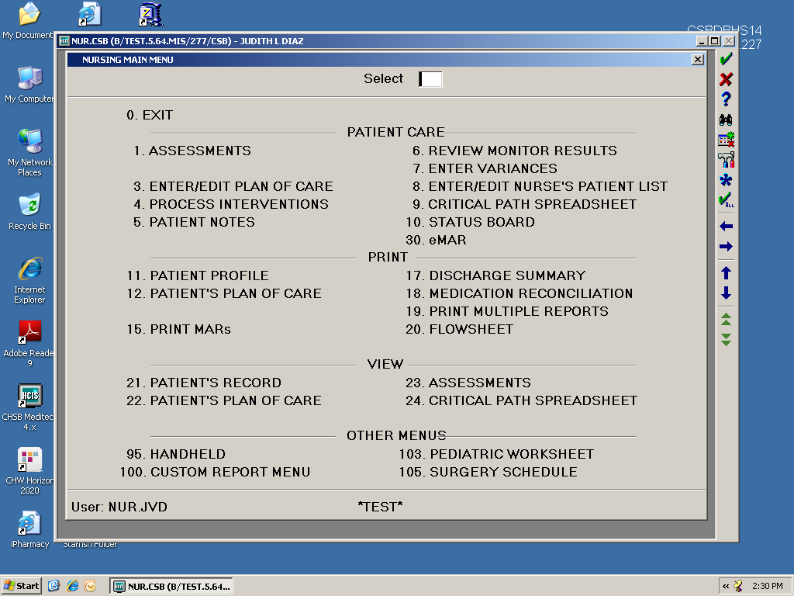
Creating a Plan of Care
Nursing Module:
1. Click Enter/Edit Plan of Care

Slide 28
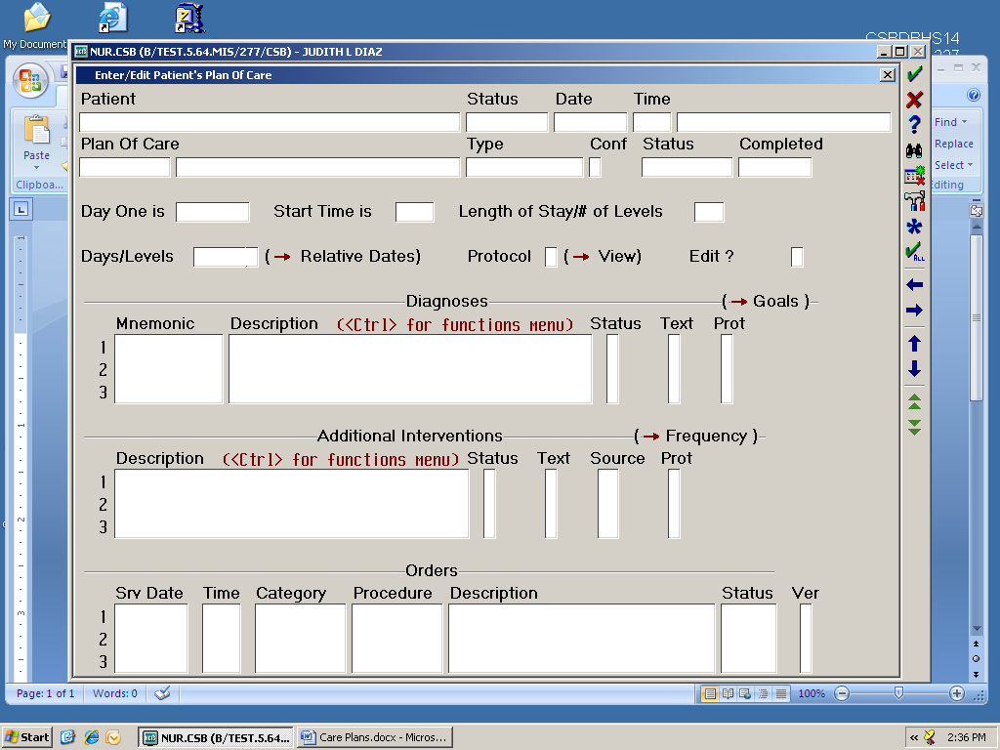
Creating a Plan of Care
Nursing Module:
Enter your patient’s name. Identify the patient correctly by VERIFYING the V number or M number

Slide 29
Creating a Plan of Care
Nursing Module:
Type the first 3 letters of the medical diagnosis and click F9 or “Look Up” icon and press enter to access the medical diagnosis.
Choose the appropriate medical diagnosis

Slide 30
Creating a Plan of Care
Nursing Module:
After choosing the appropriate medical diagnosis, continue by pressing the ENTER button until you see a screen that says “OK to INITIALIZE?”
Click “Yes” to initialize Plan of Care

Slide 31
Individualizing Plan of Care
Nursing Module:
Highlight EACH nursing diagnosis and press CTRL button to access Diagnosis Option screen
Highlight EDIT TEXT and press CTRL button to start entering R/T (related to:)

Slide 32
Individualizing Plan of Care
Nursing Module:
Enter condition related to existing patient’s nursing diagnosis
Press F12 or click the Save button 2 times to complete and return to list of nursing diagnoses
Repeat procedures 7-10 for each Nursing Diagnosis

Slide 33
Individualizing Plan of Care
Nursing Module:
12. Continue individualizing the plan of care by adding GOALS and respective INTEVENTIONS as applicable.
13. Highlight the nursing diagnosis and press SHIFT & RIGHT ARROW at the same time to access this screen

Slide 34
Individualizing Plan of Care
ADDING GOALS:
14. Go to a blank space and add GOALS as appropriate. Click F9 or the Look Up icon to access the list of possible GOALS. Choose the appropriate GOAL and Save by pressing F12 or clicking the Save icon.

Slide 35
Individualizing Plan of Care
ADDING INTERVENTIONS:
15. To add INTEVENTIONS, click on a blank space on the Intervention Area and type the first 3 letters of the appropriate intervention. Click F9 or the Look Up icon for the list of interventions.

Slide 36
Individualizing Plan of Care
Repeat the same procedure for each nursing diagnosis.

Slide 37
Individualizing Plan of Care
ADDING MEDICAL
DIAGNOSIS:
To add Medical Diagnosis, go to a blank space in the Nursing Diagnosis area and place a / (slash) prior to entering the first 3 letters of the Medical Diagnosis. Press F9 or click the Look Up icon to access the list. Choose the appropriate Medical Diagnosis and repeat procedures 7-14.

Slide 38
Updating Plan of Care
Plan of care is to be kept accurate and current and updated on a regular basis:
When a goal is met/revised
When a problem is added or resolved
When interventions are added/deleted/performed/
frequency changed
Updated to reflect changes/plans identified in Treatment Team

Slide 39
Documentation
Remember :
If it is not documented it is not done!

Slide 40
Final Exam
After reviewing the module,
complete the ON-Line Post Test
and
develop a written
“PLAN of CARE”
based on the following scenario and submit it to your educator or to Education Dept.
You will NOT receive credit if you do not submit your
completed plan of care.

Slide 41
Case Scenario
This is the case of Mrs. D, a 35 y/o who presented to the ED with chief complain of “heartburn.” The symptom started when she was sitting at home watching TV approximately 2 pm when she experienced “heartburn.” Assuming the discomfort was because of something she ate, she dismissed the discomfort and took Tums. After about two hours, she explains the “heartburn” was not getting better and it was now more of a dull pain that seemed to spread to her shoulders. She also started to have shortness of breath, and so it prompted her husband to call 911.
While in the ED, Mrs. D seemed to be holding on to her chest and looked teary-eyed. When asked about any pain, she described pain in her chest as “burning” and with a score of 6 from a scale of 1-10. She verbalized feeling “scared and worried” of her condition. Her husband at the bedside for support.
Past medical history includes two normal deliveries, history of diabetes mellitus diagnosed after she had her 2nd child 5 years ago. A history of hypertension that is controlled with medication. She has no family history of any medical problems. Both parents are well and her only sibling is also well and healthy.

Slide 42
Case Scenario
She is currently on Glucophage 500 mg twice a day and Toprol 50mg once a day.
Vital signs were B/P 160/84, RR 20, PR 89, Temp 98.8, O2 sat 98% on room air, blood sugar 95. Blood works, EKG, chest x-ray were completed. So far, Mrs. D’s blood works and EKG were all normal, however, the physician admitted her for further evaluation.
She is currently waiting for transport to Telemetry, very anxious and scared.

