Slide 1
2-Bin Replenishment System (Pegasus KANBAN Inventory System)

Slide 2
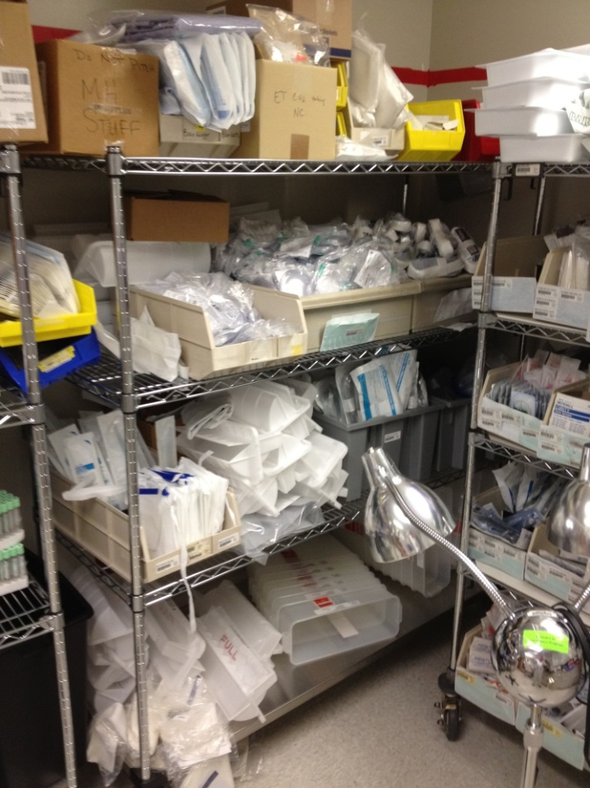
Current Process – PAR Replenishment
Does this sight look familiar to you?

Slide 3
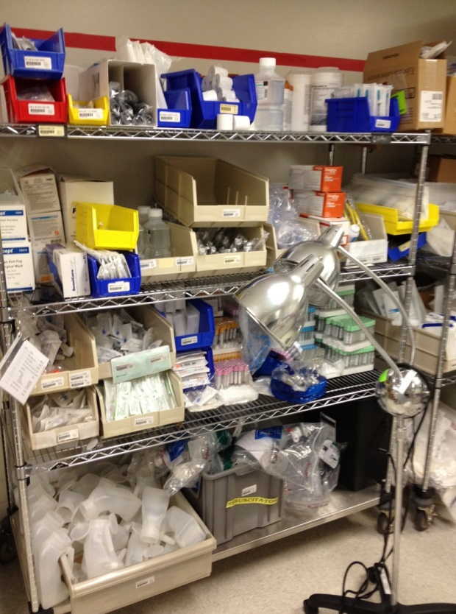
Current Process – PAR Replenishment
Challenges with the Current Process…
Space Constraints
Most PAR locations are located in small supply storage rooms, weekly deliveries of non-PAR’d supplies to compensate the lack of space
Current wire shelving does not maximize storage space
Item locations are not standardized, difficult to locate between departments
Current bin system promotes clutter and overstocking
Both MM techs and clinical staff have difficulty finding items for use and replenishment
Productivity Challenges
Current PAR process requires MM (Materials Management) techs to “top off” supply bins based on PAR levels; need to memorize PAR quantities
Requires two trips to location daily – once to count and then to replenish, inventorying typically takes 20–40 mins per department, then restocking takes around 20 mins
Inconsistency in PAR replenishment
Need for weekly issues of non-PAR’d supplies to departments; constant stock-out or after hours shopping

Slide 4
Current Process – PAR Replenishment
Challenges with the Current Process…
Inventory Management Challenges
Obsolescence and stock rotation difficult to manage, increased risk of items expiring
“Eye-balling” leads to overstock or stock-out in both the PAR area and storeroom
Clinical staff may be tempted to store and hide unofficial inventory to compensate for inefficiencies
Employee Relation Challenges
MM techs and clinicians blame each other for stock-out situations because the area is difficult to manage
MM techs blame each other for stock-outs and overstock when covering for PTO and scheduled days off because there is no standard process

Slide 5
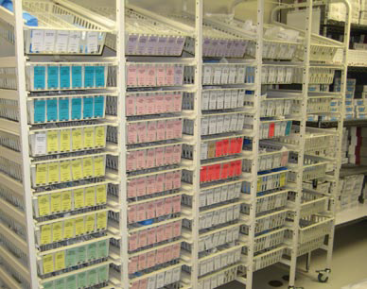
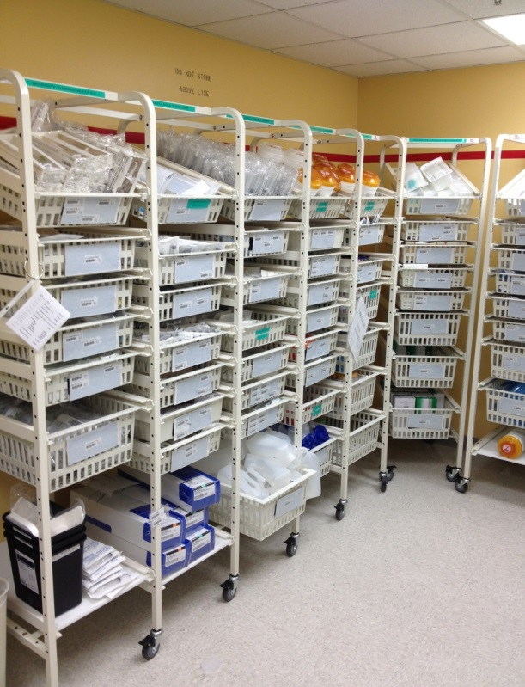
2-Bin Replenishment Proposal (KANBAN)
How about changing the sight to this?

Slide 6
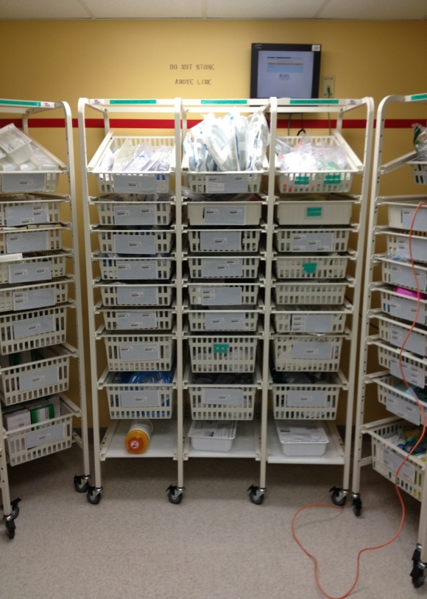
2-Bin Replenishment Proposal (KANBAN)
Space Maximization
The Pegasus KANBAN (2-Bin) Inventory System is comprised of High Density Basket Storage
High Density Storage provides up to 60% additional storage capacity as compared to flat shelving.
Wire shelving will be used for bulkier items such as adult diapers, glove boxes and washbasins
2-Bin will be maintained by placing items side by side
The clinical staff will have a much easier time finding supplies as they are organized in the baskets and in stock
Productivity Maximization
MM techs scan empty compartments inside baskets, reducing the time MM tech is in each department
Since only empty compartments are scanned this will reduce the number of line items to be replenished
Reduces the time picking up supplies: less supplies scanned, less time to pick up supplies; less supplies picked up, less time to replenish supplies
Supplies are rotated when supplies are replenished

Slide 7
2-Bin Replenishment System
How the 2-Bin System works:
Baskets are divided in half so that the front half is identical to the back half
Basket compartments have their own unique Lawson barcode
Par levels are determined & properly set to match restocking schedules & are split between matching front & rear basket compartments
MM techs only look for and scan the empty compartments
MM techs scan, pick & restock up to 70% fewer items on a daily basis
If the front compartment is empty, nursing will always have supplies in the rear compartment
Very Important Reminders:
NEVER use the back-up bins unless the supplies in the front bin are all used up and empty
NEVER rearrange the supplies for staff convenience --- specific Lawson codes are placed on each bin for ease of scanning

Slide 8
How KANBAN works - Video
Click below to play the training video
◆ High Density Two-Bin Par Management System Video
VERY IMPORTANT:
Please make sure that the powerpoint is in the “slide show” mode before clicking the link above, otherwise, the video will not play.
If the video does not play, please locate the icon for the slide show at the right side of the bottom part of the screen. (see sample illustration below)
click this icon located at the bottom of the screen

Slide 9
Questions?

Slide 10
Thank you

